Slide 1
BEFORE THE BELL
Turn in your argument paper to your class tray!
Any late work should go into the late tray (it’s at the very bottom!)
Get your vocab book out and open it to UNIT 2

Slide 2
Intro to VOCAB UNIT 2!
After introduction you will complete the synonym and antonym section in your book!

Slide 3
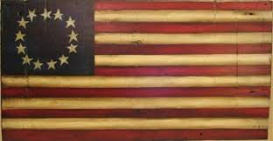
Declaration of Independence

Slide 4
Video
http://youtu.be/s2VBFB0MCjc
Take out a sheet of paper and identify appeals for each:
ETHOS
PATHOS
LOGOS

Slide 5
Analyze passages….Ethos, Pathos, Logos
“We hold these truths to be self-evident” Line 7
“Endowed by their Creator” Line 8
“Unalienable rights” Line 8
“secure these rights” Line 9-10

Slide 6
Let’s get with our group!
Find your famous couple friend!
You will need a piece of paper and a book open on your desk!

Slide 7
Work to answer these questions THESE ARE ON P. 245 OF THE BOOK!
1. Name three complaints the colonist had against the king.
2. What rights are specified in the Declaration?
3. What does Jefferson say is the purpose of government?
4. According to the declaration, who give people their rights?

Slide 8
Analyze an Argument
Create this chart in your group:
Work through identifying the elements of this persuasive passage
Argument Element | Citation and Explanation
CLAIM:
SUPPORT:
COUNTERARGUMENT:
CALL TO ACTION:

Slide 9
QUIZ TIME!
Independently utilizing your answers and group work take a practice quiz!
This quiz is very similar to questions you will be asked on your test!
Yes this is an informal grade so you have to finish before the bell!

