Slide 1
Before Bell You have a quiz today! Study!!!!

Slide 2
Warm-up: Timeline put these event in the correct order!
Tom stabs Chambers.
Angelo and Luigi arrive in town
Thomas and Chambers are born.
David Wilson arrives in town and quickly earns the nickname “Pudd’nhead.”
Pudd’nhead fingerprints Chambers and Thomas.
Tom’s father (Percy Driscoll) dies: Tom is adopted by Judge Driscoll, and Roxy is set free.
Thomas’ mother dies in childbirth leaving Roxy to care for him.
Roxy switches the babies.

Slide 3
Warm-up: Timeline Correct!
Thomas and Chambers are born.
Thomas’ mother dies in childbirth leaving Roxy to care for him.
David Wilson arrives in town and quickly earns the nickname “Pudd’nhead.”
Pudd’nhead fingerprints Chambers and Thomas.
Roxy switches the babies.
Tom stabs Chambers.
Tom’s father (Percy Driscoll) dies: Tom is adopted by Judge Driscoll, and Roxy is set free.
Angelo and Luigi arrive in town

Slide 4
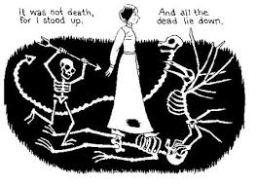
After Quiz
Read about Emily Dickinson P. 546
1.) Write down 5 very unusual things about her and anything else that you find interesting. Using the notes sheet
2.) In your own opinion... What is one crucial difference between the forerunners of modern poetry, Whitman and Dickinson?
Whitman was open and willing for readers to appreciate his poetry. Dickinson was shy and acted as a recluse.

Slide 5
Emily Dickinson 1830-1886
She, along with Whitman, is credited with “all but inventing American poetry.”But they didn’t even know each other.
Dickinson was asked once about Whitman.
She said, “I never read his Book—but I was told that he was disgraceful.” (Remember the rumors surrounding Whitman.)
Well, I guess she wasn’t perfect (judging people based on their supposed behavior and all).
Anyway. Remember William Carlos Williams? The wheelbarrow guy?
He called Dickinson his “patron saint.”
“She was an independent spirit. [ . . . ] She didn’t want to be confined to rhyme or reason.”
That sounds about right.

Slide 6
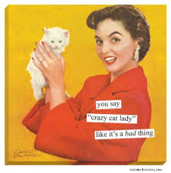
So in essence….
Emily was a recluse
She lived in her family home for most her life
For most of her life she did not come out and would only talk to her doctor through a door.
She sent most of her poems to relatives in letters…which is kinda creepy because she was ill and most her poems were about death…

Slide 7
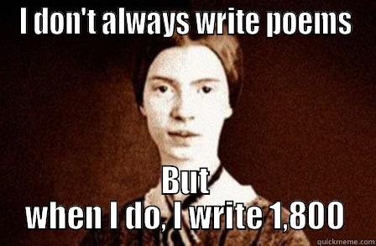
Dickinson’s Style

Slide 8
SLANT RHYMES
a type of Rhyme formed by words with similar but NOT identical sounds.
IT ALMOST rhymes- but doesn’t DIRECTLY RHYME…
Example: (Rap)
“yo it kind of make me think of way back when, I was a portrait of the artist as a young man, Writing rhymes on napkins,
Was really visualization, making this here actually happen.”

Slide 9
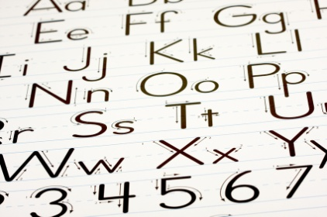
Irregular Capitalization/ DASHES
Different words capitalized in the middle of sentences…
Dashes used to add emphasis or to create a dramatic pause
Example:
Much Sense—the starkest Madness--

Slide 10
Inverted SYNTAX
Like the way YODA talks….
when lines do not follow traditional sentence patterns-
when the subject and verb are reversed.
Example: “Agree with you, the council does. Your apprentice,
Skywalker will be.”
“Much to learn you still have.”

Slide 11
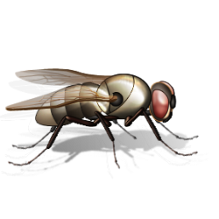
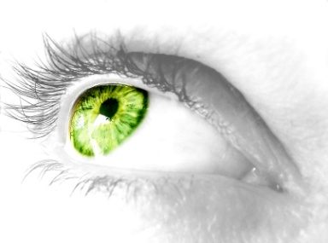
Interesting Comparisons…
“My Life stood- a Loaded Gun”
“Hope is the thing with feathers/ that perches in the soul”
“I heard a Fly Buzz when I Died”
Unconventional Comparisons/Fresh metaphors and similes!

Slide 12
Dickinson’s STYLE
Her Poetry is VERY unique and Personal – Just like her observations about the world!
1) ________________ or -4 lined stanzas
2) __________ Rhyme -words that don’t exactly rhyme
3) Irregular capitalization and _________ syntax
4) Surprisingly unconventional figurative language (similes, metaphors, and personification)
http://www.youtube.com/watch?v=R4WwhOdk_Eg

Slide 13
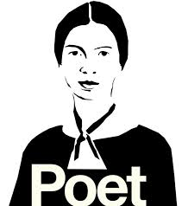
Dickinson
First poems published after her death in 1890.
They were heavily edited to remove the weirdness.
Let’s compare.

Slide 14
Dickinson’s original Edited for publication
Much Madness is divinest Sense--
To a discerning Eye--
Much Sense--the starkest Madness--
‘Tis the Majority
In this, as All, prevail--
Assent--and you are sane--
Demur--you’re straightway dangerous--
And handled with a Chain—
Much madness is the most divine sense
To a discerning eye.
Much sense, the starkest madness.
‘Tis the majority in this, as all, prevail.
Assent, and you are sane.
Demur, you’re straightaway dangerous
And handled with a chain.

Slide 15
Independent Work- “reading poetry”
1.) On P. 548 read “Because I could Not Stop for Death”
1.) 1st Reading- structure and rhythm
2.) 2nd Reading- figurative language & capitalization
3.) 3rd Reading- Imagery & figurative language conveying meaning
Then with a partner work through to answer the questions for this poem. Be prepared to explain/discuss your findings.

Slide 16
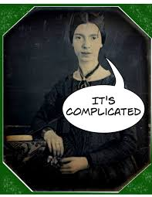
Closure
Choose an everyday simple object that you use…
Utilizing Dickinson’s style write a poem about this object
The key is to be like her utilize slant rhymes, quatrains, inverted syntax, irregular capitalization to show your true abilities

