Slide 2
Warm Up:
Journal:
Have you ever had to face an unpopular or hard decision in your life? What choice did you make?
How did this choice effect you (Negative/Positive)?
Would you looking back (hind sight is always 20/20) make the same decision?

Slide 3
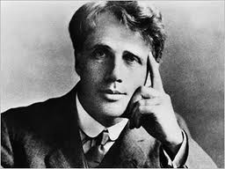
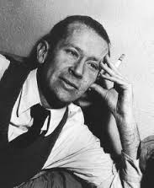
Robert Frost & ee cumming’s Biography
Write 5 facts you learn about Robert Frost’s life and influence!
http://youtu.be/o2stTH-rtq8
Now 5 facts you learn about e.e. cumming
http://bcove.me/897o9nq1

Slide 4
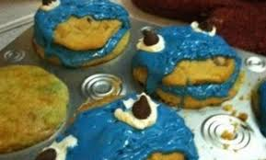
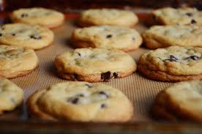
Imagism
Poetry based off of imagery it speaks to your five senses
How do you create that?
Diction
Imagery
Theme

Slide 5
Frost “The Road Not Taken”
The Road Not Taken
BY ROBERT FROST
Two roads diverged in a yellow wood,
And sorry I could not travel both
And be one traveler, long I stood
And looked down one as far as I could
To where it bent in the undergrowth;
Then took the other, as just as fair,
And having perhaps the better claim,
Because it was grassy and wanted wear;
Though as for that the passing there
Had worn them really about the same,
And both that morning equally lay
In leaves no step had trodden black.
Oh, I kept the first for another day!
Yet knowing how way leads on to way,
I doubted if I should ever come back.
I shall be telling this with a sigh
Somewhere ages and ages hence:
Two roads diverged in a wood, and I—
I took the one less traveled by,
And that has made all the difference.
http://youtu.be/KUaQgRiJukA

Slide 6
e.e. cumming “dive into dreams”
“dive for dreams or a slogan may topple you (trees are their roots and wind is wind) trust your heart if the seas catch fire (and live by love though the stars walk backward) honour the past but welcome the future (and dance your death away at this wedding) never mind a world with its villains or heroes (for god likes girls and tomorrow and the earth)”
― E.E. Cummings

Slide 7
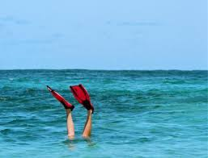
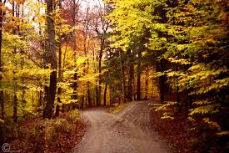
Diction, Imagery, Theme Venn Diagram
Compare and Contrast the images, diction, mood of these two poems
1.Pull out specific words of diction that helped to create the author’s tone
2.What imagery is created, pull out two examples of clear images they speak about in their poems. What sense are they appealing to?
3.What is the theme of the two poems? Are they similar?

Slide 8
Snapchat your life!
Looking at the theme from these two poems create a poem that mirrors either EE Cumming or Frost Style; It should be a about YOU!
This should contain IMAGISM techniques we have discussed….diction, imagery, theme should be clear in 10 lines
Create a snapchat visual of your poem (What would the reader be able to see in a 10 second view of your poem?)

