Slide 1
Before the Bell:
Get your notebooks in order
  1st divider should be WARMUP --put some notebook paper here!!!
  2ND divider should be NOTES
  3rd divider should be DATA
  4TH divider should be GRAD PAPER
  5th Divider should be NOVELS

Slide 2

Warm Up:
On a sheet of scratch paper what are 5 topics you would be interested in working on this semester for your Junior Grad Paper?
Advice think about topics that you want to major in in college, courses you have liked, things your read/watch news coverage of, clubs or work you already do……

Slide 3


Grad Project- Fun TIMES!

Slide 4

What is the Graduation Project?
The Graduation Project is an opportunity to pursue resolution of a question about which you have genuine concern.
The question may grow out of interest that you have had for some time or one that has arisen recently through course work or personal experience.
As you identify and pursue resolution of your question, you will learn a great deal about your topic and yourself.

Slide 5


Guidelines
Paper must be in MLA Format
Paper must be 6-8 pages in length (not including work cited page)
You must use in-text citations (quotes/paraphrasing)
You must include a visual (graphic of some type) THAT YOU MAKE!!!
You will choose this topic…..pick something you like it will be with you for 2 years!

Slide 6

Grad Paper Portfolio
This Portfolio is worth a TEST GRADE = 50 POINTS FORMAL
How to get an A? Turn all of it in on time completed….yes its that easy!
Topic Approval
Work Cited
Outline
First 3 Pages
Rough Draft Final
Final Draft

Slide 7
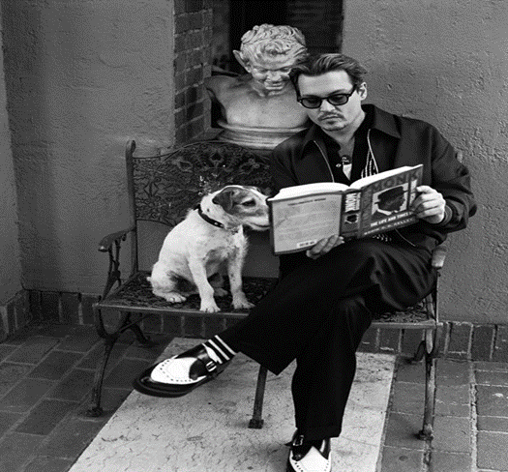
What is new?
The paper is still the same. I am your mentor/Teacher I will give you ample time and feedback!
If you want another mentor you must ask them and let me know!!!!!!
Senior Year Product is a bit different
COMMUNITY Service/ Learning hours minimum of 15 hours

Slide 8
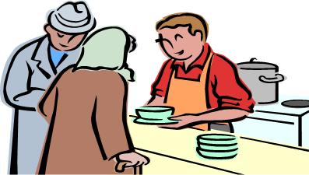

What is Community Service/Learning
Actual community service (Food Kitchens, Fundraisers, Clubs etc)
  Example: Paper topic is on Animal Cruelty and the need for more harsh laws on abusers… you could volunteer at an animal shelter or create a drive for animal supplies to bring to the shelter…
Service Learning ( Job Shadow, Actual performance of Job etc)
  You wrote a paper about GMO’s and Hormones Negative effects in our foods. You could volunteer at an organic farm and learn all about organic farming and pick some veggies!

Slide 9

Do Not Stress the Service Product!
You are not seniors, I am not your senior English Teacher!
All I want you to think about is:
  Can I do something for 15 hours in some way shape or form with this paper?
    If NO DO NOT CHOOSE THAT TOPIC!
Topics are approved by me but I reserve the right to VETO any I feel will be to difficult to research or work with next year!
This paper is 20% of your Q4 grade…it requires you to be organized and work outside of class!

Slide 10

Today:
We will be going to the Media Center!!!!
You will be taking your possible topics and looking into them to see what or if you are still wanting to write about them and at least narrowing down to TWO!
Hopefully you will pick your topic and complete this form for your parents to sign off on.
  This Topic Approval Form is part of your Grad Portfolio this one is due 1/ 28 Next Wednesday!

