Slide 1
Harlem Renaissance

Slide 2
Before the bell
Pick up one of each of the forms on the front table!
Please have your graduation paper and portfolio ready to turn in on YOUR DESK…this means stapled and ALL before the bell!

Slide 3
Grad Paper Reflection
Take the handout and complete the reflection. There should be more than a few words per answer. This is the chance you have to give me feedback PRIOR to reading your paper.
Remember if your audience goes in to your paper frustrated you are fighting an uphill battle….

Slide 4
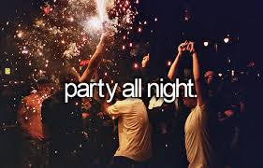
YAY!!!!!
For those of you turning in your paper…YOU ARE DONE WITH THE LARGEST PAPER of your Junior year!!!!
A BIG WHOHOOO!
Now less stress?!?!
At least less HW?!?!
You have 15 days left?!
Celebrate something!!!

Slide 5
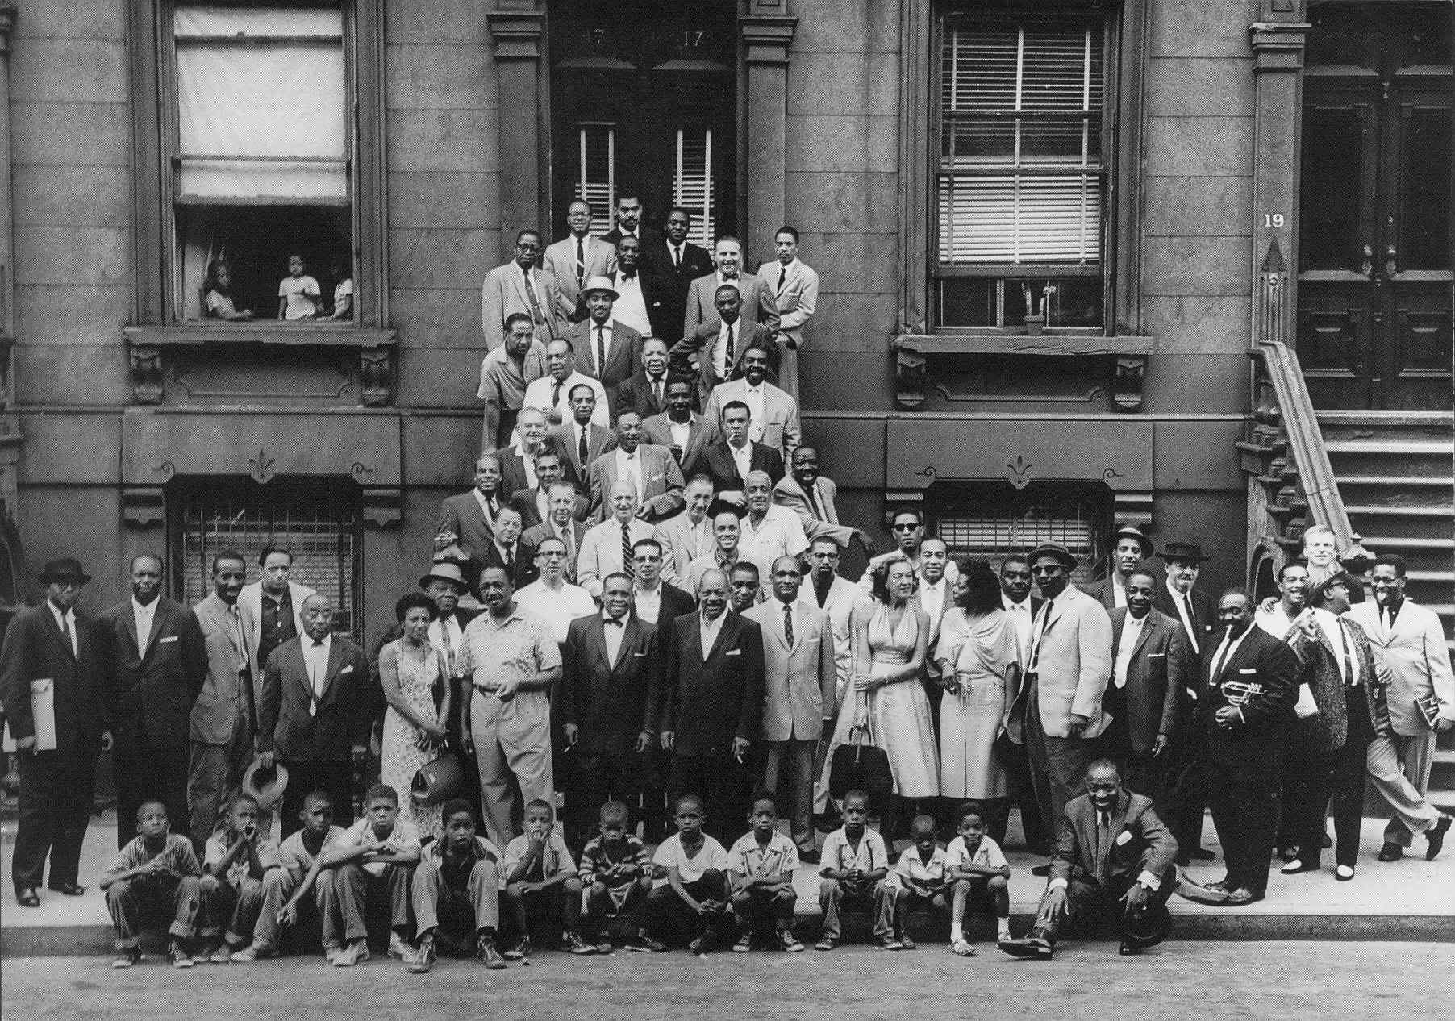
Harlem Renaissance Review
Review the Harlem Renaissance and it’s impact on culture and society!
http://www.history.com/topics/roaring-twenties/videos/the-harlem-renaissance

Slide 6
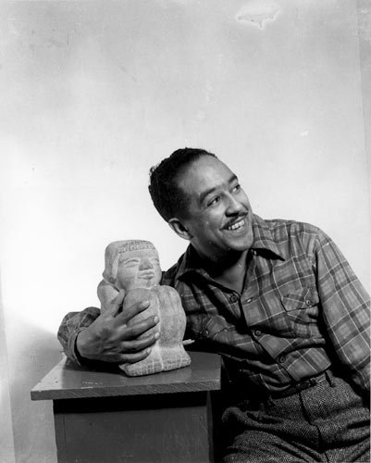
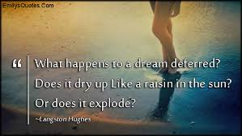
Langston Hughes
http://youtu.be/ir0URpI9nKQ?t=3m1s
What are 5 things you learned about Langston Hughes life ?
What do you think influences his writings?

Slide 7
I Too
You will Discuss this poem “I, Too”
With a partner- Fill out the Questions –ONLY Do step1
Write two discussion questions about Theme, Tone, Speaker, Figurative Language, Diction, Connotation, or Imagery.
You have 15 minutes to finish the sheet. Do not waste Time. Be prepared to discuss I will call on you at random!

Slide 8
Your Groups Turn
Now write your own Poem.
1. Write a poem where you address an issue in America that you think needs to change 10-15 lines!
2.You should Model the same style as Langston Hughes
3. Create a visual image to go with your poem that mirrors the imagery you use in the poem .
Be creative. We will share these at the end of class.

Slide 9
Closure
Poem Presentations
Reminders:
You need your VOCAB books next week ☺
Keep reading Great Gatsby…next Wednesday is your quiz need study guide!

