Slide 1
Bell Work
Puddn’Head Wilson Quiz Ch. 8-13 Today!
Please take your study guides out I will come around and check these while you take the quiz to give you credit.
YES you can use these on the quiz!

Slide 2
Warm Up: Pudd’nhead timeline
Tom learns who his father is.
Luigi challenges Tom to a duel.
Tom learns that he is Roxy’s son.
Roxy loses all her money she made while working on a steamboat.
Roxy learns about Tom’s gambling/financial problems.
Tom feels awkward in social settings and begins to doubt himself.
Wilson reads Luigi and Tom’s palms.
Roxy loses all her money she made while working on a steamboat.
Roxy learns about Tom’s gambling/financial problems.
Tom learns that he is Roxy’s son.
Tom learns who his father is.
Tom feels awkward in social settings and begins to doubt himself.
Wilson reads Luigi and Tom’s palms.
Luigi challenges Tom to a duel.

Slide 3
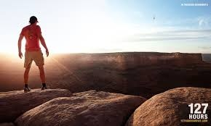
After the Quiz!!!
Pick up your book and read page 768
Jack London Bio
Write 5 interesting facts about him you learned on the back of your worksheet!

Slide 4
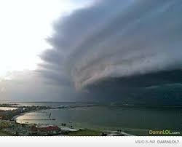
Naturalism
Nature is against man
Effect of natural and social forces on the individual
Human destiny is beyond human control
Portrayed rich in a poor light.
Mythic situations – open sea, deserted island, wilderness, etc.
Fate is determined by forces beyond individual control.

Slide 5
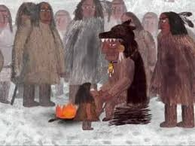
Jack London
The Law of Life
Notes:
R3: Analyze the impact of the author’s choices regarding how to develop and
relate elements of a story or drama (e.g., where a story is set, how the action is
ordered, how the characters are introduced and developed).
R4: Determine the meaning of words and phrases as they are used in the text,
including figurative and connotative meanings; analyze the impact of specific
word choices on meaning and tone, including words with multiple meanings or
language that is particularly fresh, engaging, or beautiful. (Include Shakespeare
as well as other authors.)
R5: Analyze how an author’s choices concerning how to structure specific parts of
a text (e.g., the choice of where to begin or end a story, the choice to provide a
comedic or tragic resolution) contribute to its overall structure and meaning as
well as its aesthetic impact.
R9: Demonstrate knowledge of eighteenth-, nineteenth- and early-twentieth-century
foundational works of American literature, including how two or more texts from
the same period treat similar themes or topics.
W2b & c: Develop the topic thoroughly by selecting the most significant and relevant
facts, extended definitions, concrete details, quotations, or other information
and examples appropriate to the audience’s knowledge of the topic.
c. Use appropriate and varied transitions and syntax to link the major sections
of the text, create cohesion, and clarify the relationships among complex
ideas and concepts.
W3: Write narratives to develop real or imagined experiences or events using
effective technique, well-chosen details, and well-structured event sequences
OBJ: Develop stories with naturalism characteristics
Modeling – use the modern examples/article on real man vs. nature elements
Teacher guided notes
Ind practice: writing own story
Closure: exit ticket, choral answer!

Slide 6
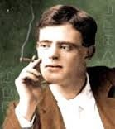
Jack London
This guy was amazing.
Called to adventure – poor, laborer in many industries (hmm… how would that shape his attitude?)
At 16 – oyster pirate! ARG!
Seal hunting at 17. Alaska!
Arrested for being homeless!
True rags to riches story.

Slide 7
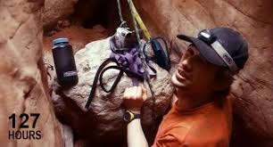
Modern Naturalism
Hunger Games
Into the Wild
Man V Wild
Man versus Nature
How does this clip represent naturalism?
Are people a product of their environment?

Slide 8
Literary Devices Review
Foreshadowing: hints or clues…
Point of view
1st person
3rd Person
Rarely ever see 2nd
Limited or omniscient?
THEME: not 1 or 2 words – it’s a MESSAGE, lesson. Try to avoid clichés.
VOICE/SPEAKER: The person who is likely talking. It’s NOT usually the author.

Slide 9
After reading…
What is the task of every living thing in nature?
Find evidence (specific lines) that show elements of Naturalism.
Who is the speaker in this story? What perspective is it told from?
What event did Kookoosh witness as a teen that affected him (and becomes ironic later)?
What do you think of the conclusion of the story?

Slide 10
Creative Writing Closure
Take an experience of your own (real) and then put yourself in that moment or in a different setting or situation. Write the beginning of an adventure story.
Ex… I once had heat stroke hiking in Colorado. I’m going to change my setting and put me in a stranded life boat after a ship sank. I’m hungry, thirsty, etc… same as I felt in Colorado. Use what you know to write what you WANT. Use imagery, figurative language, tone, mood, etc.

