Slide 1
The Masque of the Red Death Edgar Allan Poe
Eleventh Grade Lesson Plan
Ashley Nickell

Slide 2
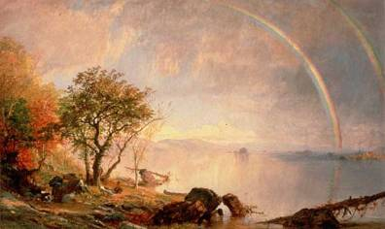
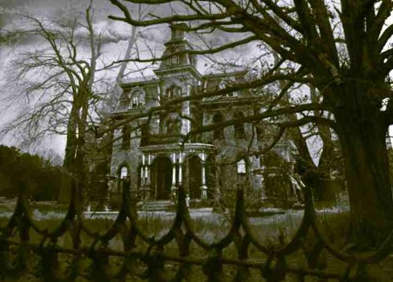
Warm Up
Please write 5 facts you learned about Poe from this video!
http://youtu.be/R9N-ZZ0Q7SM?list=PLs2T_dNZ-XW4tvX3cYwkGsObIxlbBSxIs

Slide 3
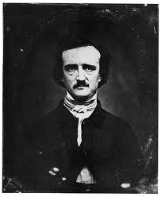
Edgar Allan Poe Intro
Edgar Allan Poe (1809-1849) was an American author. He is credited as the master of horror and the creator of detective stories.
Poe was born in to poverty and lived most of his life in poverty, working as an author and literary critic
He was abandoned by his father at birth and his mother died of tuberculosis soon after leaving him as a foster child to Mr. and Mrs. Allan
At 27 Poe married his cousin Virginia Clemm only 13, she dies of tuberculosis at age of 24.
1849 two years after Virginia’s death Poe disappears for 5 days in Baltimore and is found ill in the streets he dies a few days later. His death is still a mystery.

Slide 4
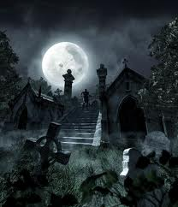
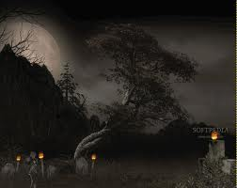
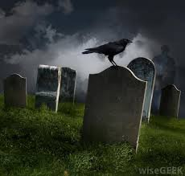
Intro to Gothic Literature
After transcendentalism and nature came….
Anti-Transcendentalism or Gothic ;.A pessimistic offshoot of romanticism
Known as the “Dark Side of Individualism” Gothic writers took a pessimistic view of humans and saw the potential for evil in all people
The focus on imagination in Romanticism led to a focus on the demonic, the fantastic, and the insane for Gothic.
‘Essential truths’ about life were found in extreme situations or the darker side of human nature (greed, betrayal, fear, etc.)
On a dark and stormy night…

Slide 5
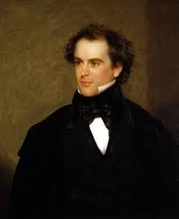
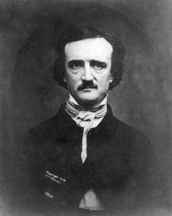
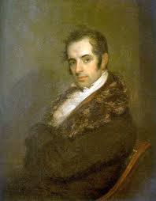
Famous Gothic Writers
Nathaniel Hawthorne
Edgar Allan Poe
Washington Irving

Slide 6
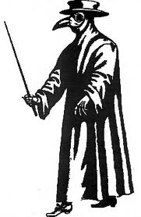
The Plague: Black Death
It was a pandemic- killed everyone indiscriminately
In the years 1348-1350 it was estimated to have killed 75 to 300 million people in Europe
It was spread by fleas on rats
People thought it was caused by bad smells, shut themselves in to avoid it.
Poe’s red death is fictional but combines the elements of the black death with symptoms of tuberculosis

Slide 7
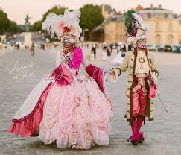
A Masque
Also known as a masquerade
A black tie costume party
At the time something the wealthy would throw in their mansions or castles.

Slide 8
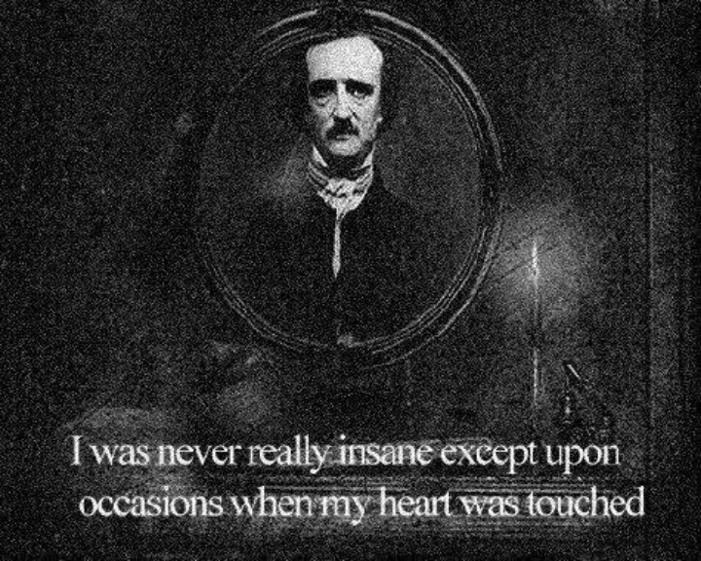
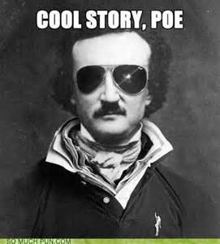
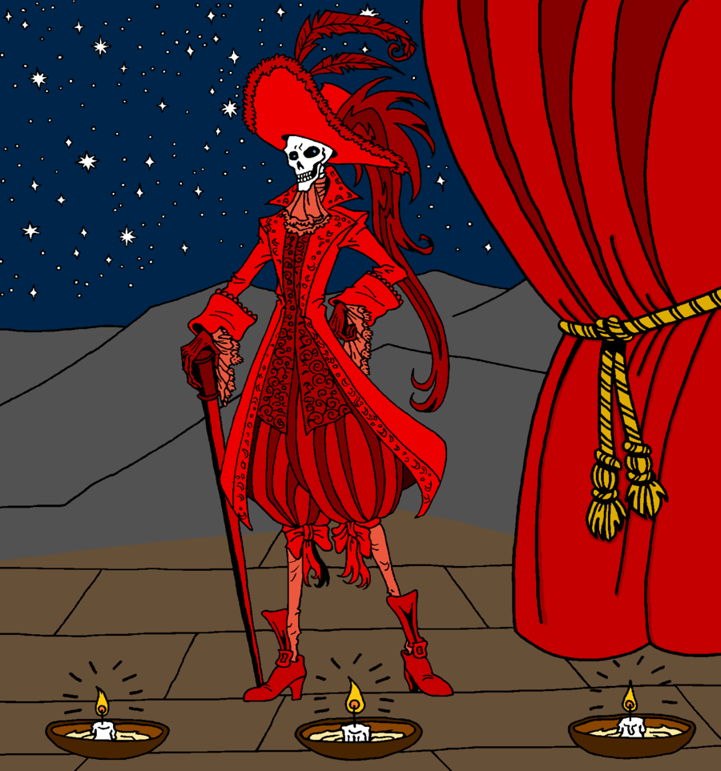
The Masque of The Red Death
Text Reading https://www.youtube.com/watch?v=m4iqBU3X4Ro

Slide 9
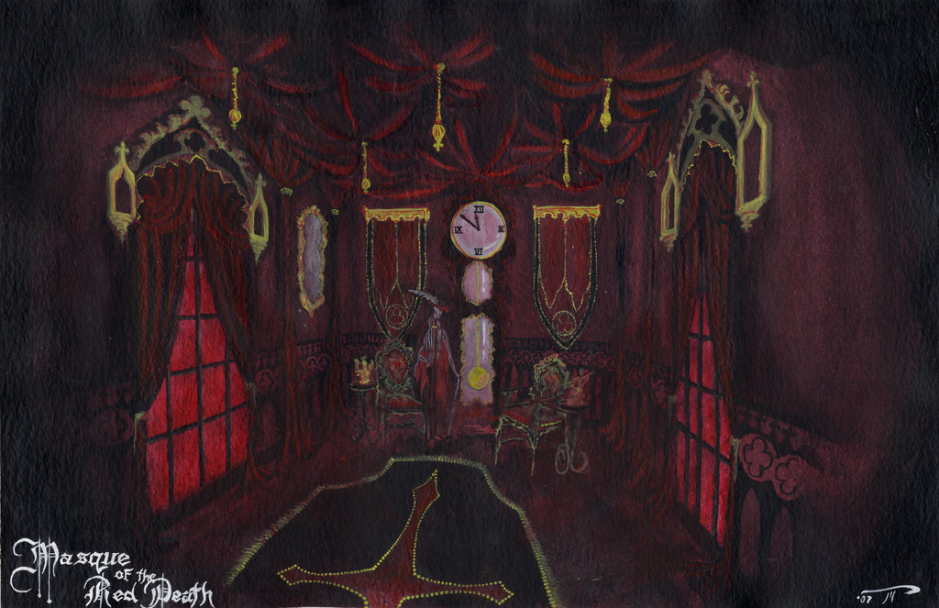
Group Activity
Trace Prince Prospero through the Abbey during the masquerade.
Work to identify the symbolism with in the story.
Create your own mask utilizing textual evidence, symbols, and character analysis.

Slide 10
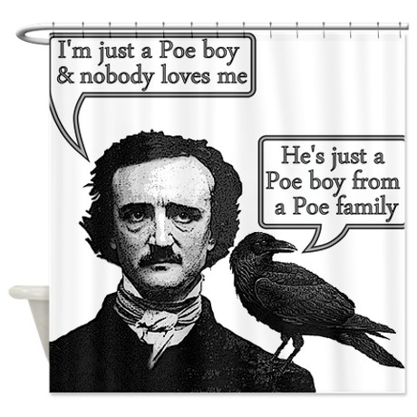
Closure
How does Poe’s diction set the mood?
http://youtu.be/lUPFX9kzfBw?list=PLs2T_dNZ-XW4tvX3cYwkGsObIxlbBSxIs

