Slide 1
Before bell: gRAB A PEER EDIT SHEET FROM THE FRONT OF THE ROOM tuRN IN ANY LATE WORK TO TRAY

Slide 2
Warm up: Peer edits
Utilize the rubric to peer edit the grad paper anonymously
MLA: Times New Romans 12 pt font, double space? Do they have their page label and header correct? Does the Work cited have a hanging indent? In-text citation punctuation?
Graphic??
Do they have enough research to back what they are writing.
No I, YOU, WE, ME?

Slide 3
Modernism
The Civil War has ended and America has just started to embark on WWI….what is going through the peoples minds? What are they feeling? How has life and the US changed?

Slide 4
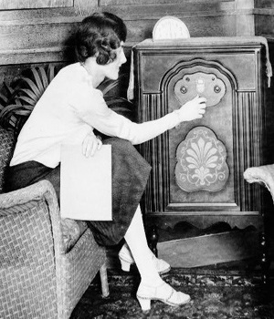
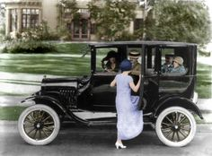
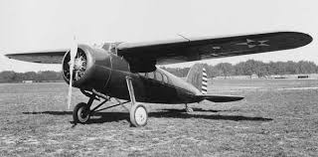
mODERNISM
Modernism: literary movement which spanned the time period between the wars 1910-1940 (Ends with WWII beginning!)
Mostly characterized by REJECTION of the PAST and EXPERIMENTATION and CHANGE for the FUTURE.

Slide 5
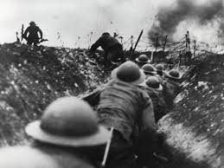
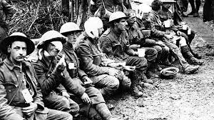
World wAR I Creates lost generation
The lost generation forms when young soldiers return home after being called to war.
The battles they experienced make them feel disillusioned by the American dream

Slide 6
The Roaring 20’s and Jazz age!
People were more focused on themselves and rejected God.
Money and riches were abundant leading the people to a morality shift seen in the club and dance scene exploding!
This is best seen in the flapper dance craze of the time to follow the new sounds of jazz music!

Slide 7
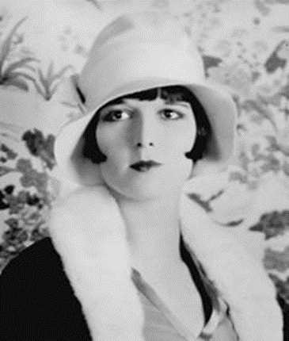
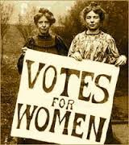
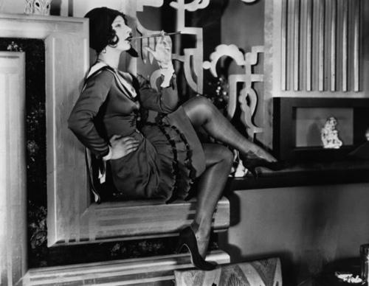
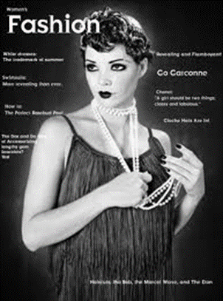
women's NEW ROLE
Women get the right to VOTE (19th Amendment)
Women’s fashion changes (FLAPPER!)

Slide 8
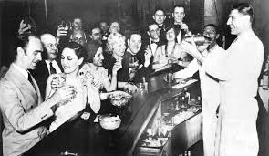
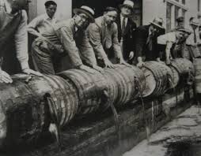
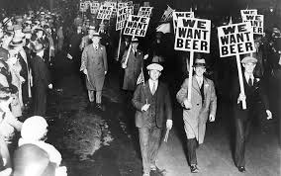
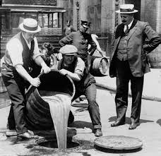
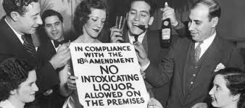
prohibition

Slide 9
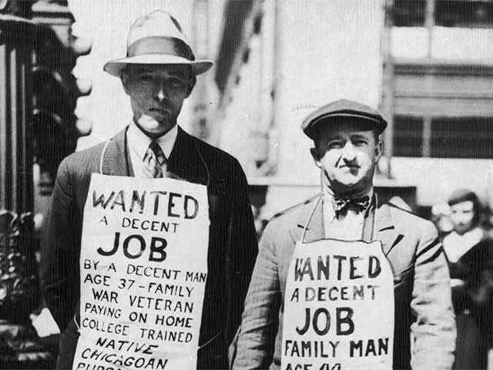
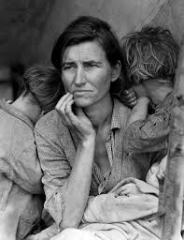
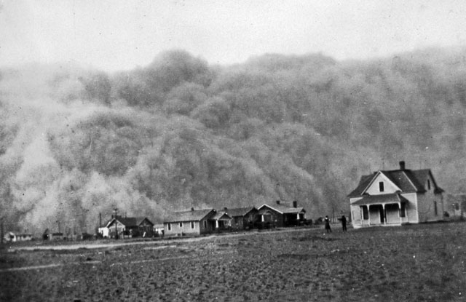
Great Depression
Though wealth and materialism had taken over the American Spirit it would not last.
The stock market crash of 1929 spurred on the Great Depression
The dust bowl destroys the farming land of the Midwest EVERYONE IS OUT OF MONEY AND NOW FOOD!

Slide 10
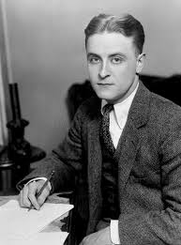
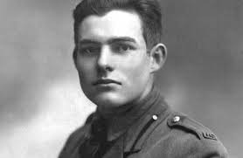
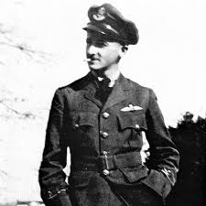
modernism literary movements:
Modernist Writers:
F. Scott Fitzgerald
Earnest Hemingway
William Faulkner

Slide 11
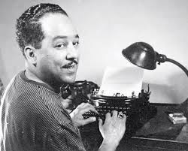
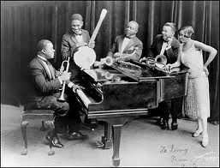
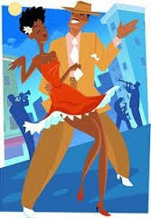
Harlem Renaissance
African American’s begin the Great Migration to northern cities and begin living in cultural centers producing art, music, and literature to depict the new freedoms but racial tensions they still face.
Writer Langston Hughes

Slide 12
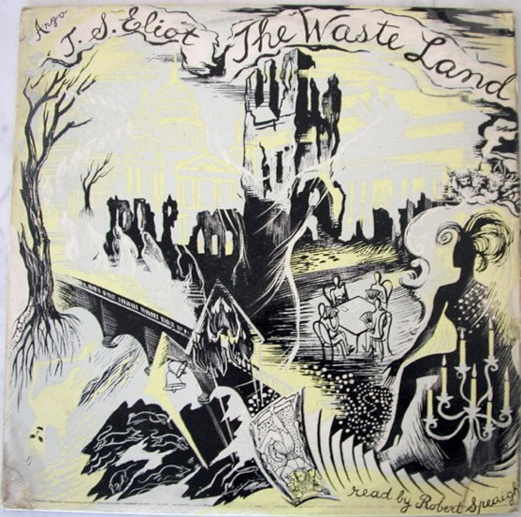
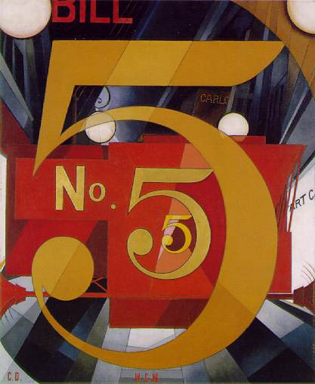
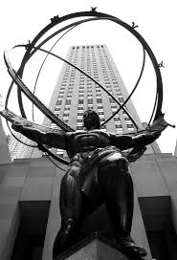
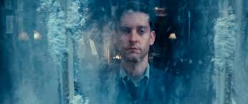
sTYLEs oF lITERATURE
Stream of Consciousness: literary style where persons thoughts and feelings (unconscious mind) are depicted in a continuous flow uninterrupted (Nick Carraway)
Imagism- Poetry in which images were presented without commentary (Ezra Pound)
Objectivism – Poetry in which object were presented and depicted on their own
Fragmented Perspective- shows the feelings of the lost generation Most famous poem is “The Waste Land” by T. S. Eliot

Slide 13
Scavenger Hunt
Go to one of the alphabet flaps around the room. In each packet there is a question read the question then find the answer at the bottom of ANOTHER flap the next question inside is your new clue ☺ search the room for it
You should write each question and each answer this will be your study guide for this unit!!!!!
This is a race so who ever finishes first with all the right answers will WIN!

Slide 14
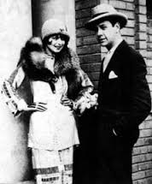
Modernism Closure
We have spent time looking at pictures, videos, and ideas of the time…..
What would you have looked like in this time frame? What would you have done? What would you write about?
Create a visual of you in the modernism time frame, with a description of your job and some things you may have written about on the bottom!

