Slide 1
O Captain My Captain

Slide 2
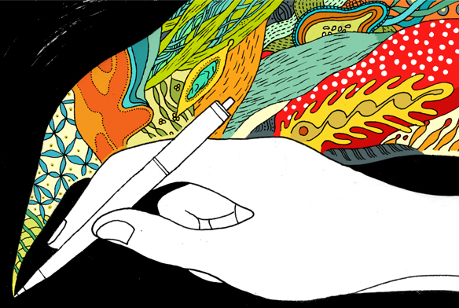
Warm Up:Review Whitman’s Style
Is this showing repetition, cataloguing, or free verse?
http://youtu.be/nfWlot6h_JM
http://youtu.be/7PCkvCPvDXk
http://youtu.be/2vjPBrBU-TM
Just for fun…what literary device is he using?
http://youtu.be/aKdV5FvXLuI (1:10)

Slide 3
Poetry analysis?
What follows on the next slide is a poem.
I want you to read the poem and answer this question using SEE.
Here’s the question:
What poetic devices does the poet use to reveal the theme of this poem?
Got the question? Here’s the poem.

Slide 4
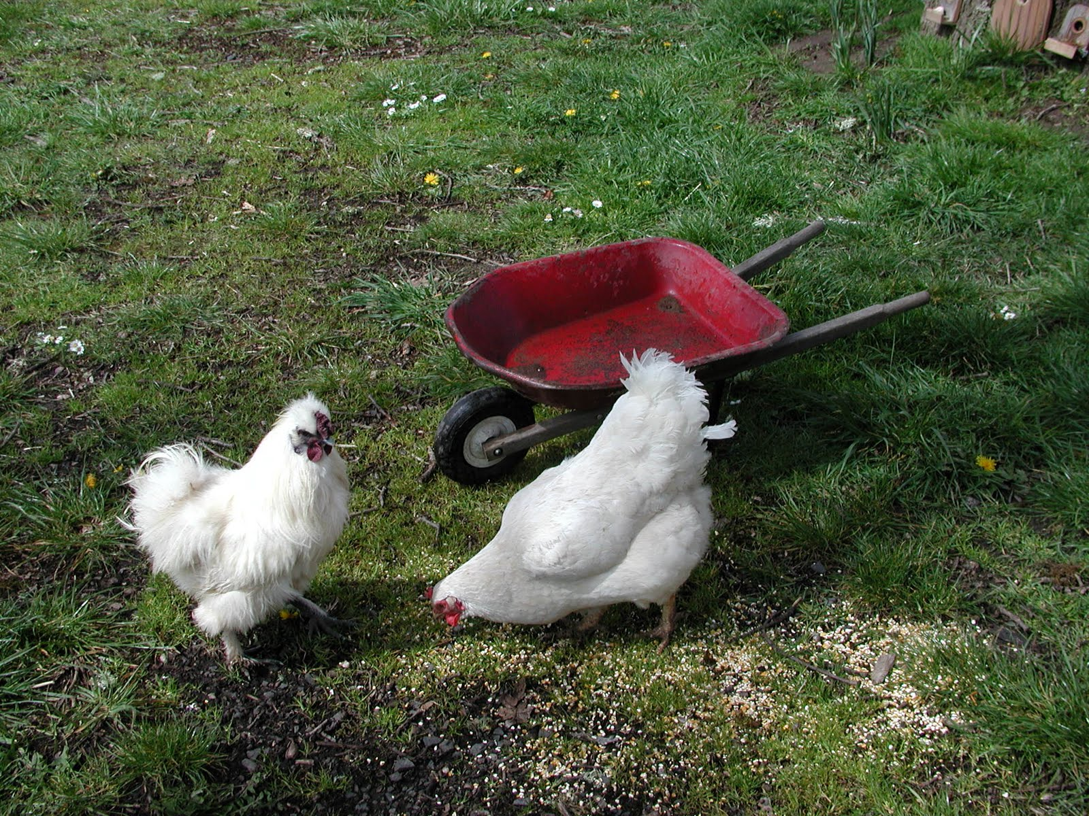
“The Red Wheelbarrow”
so much depends
upon
a red wheel
barrow
5 glazed with rain
water
beside the white
chickens.

Slide 5
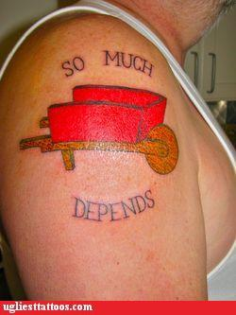
Sometimes . . .
That poem was by William Carlos Williams.
He’s actually quite famous.
But sometimes English class is too serious, and it need not be.
Sometimes the poem is just words on a page.
Or a tattoo on some dude’s arm?

Slide 6
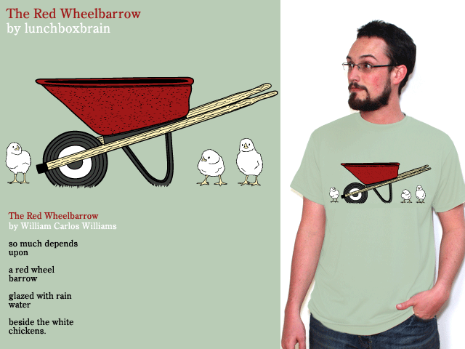
Poetry
But other people go all out:
http://www.english.illinois.edu/maps/poets/s_z/williams/wheelbarrow.htm
Don’t forget to occasionally enjoy the stuff we read.
And buy a tee-shirt.

Slide 7
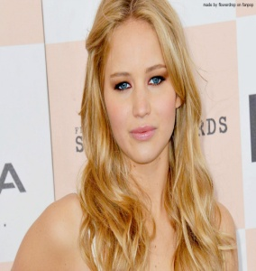
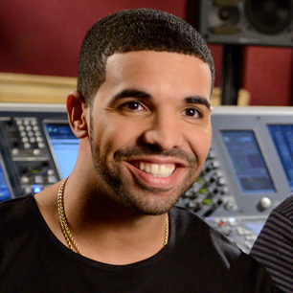
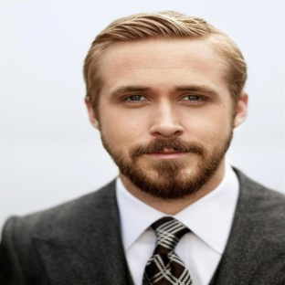
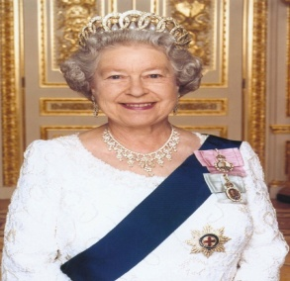
Ok back to Whitman
Have you ever felt a close personal connection to a leader, celebrity or other public figure?
Who? And Why do you admire them?
If they died during your life, how did you feel when it happened? Describe.
Or, how do you think you would feel if something bad were to happen to them?
http://youtu.be/0lREv55MY5E

Slide 8
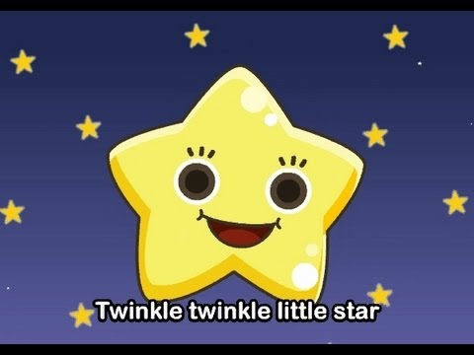
“O Captain my Captain!”
This poem uses a great deal of ‘Apostrophe’.
What is that? Yes it can be one of these Y’all rock….but in literature it is when we address someone imaginary or not there with us.
Here’s a famous example:
Twinkle, twinkle, little star, How I wonder what you are. Up above the world so high, Like a diamond in the sky.”
It also uses extended metaphors to compare someone to something over multiple lines!

Slide 9
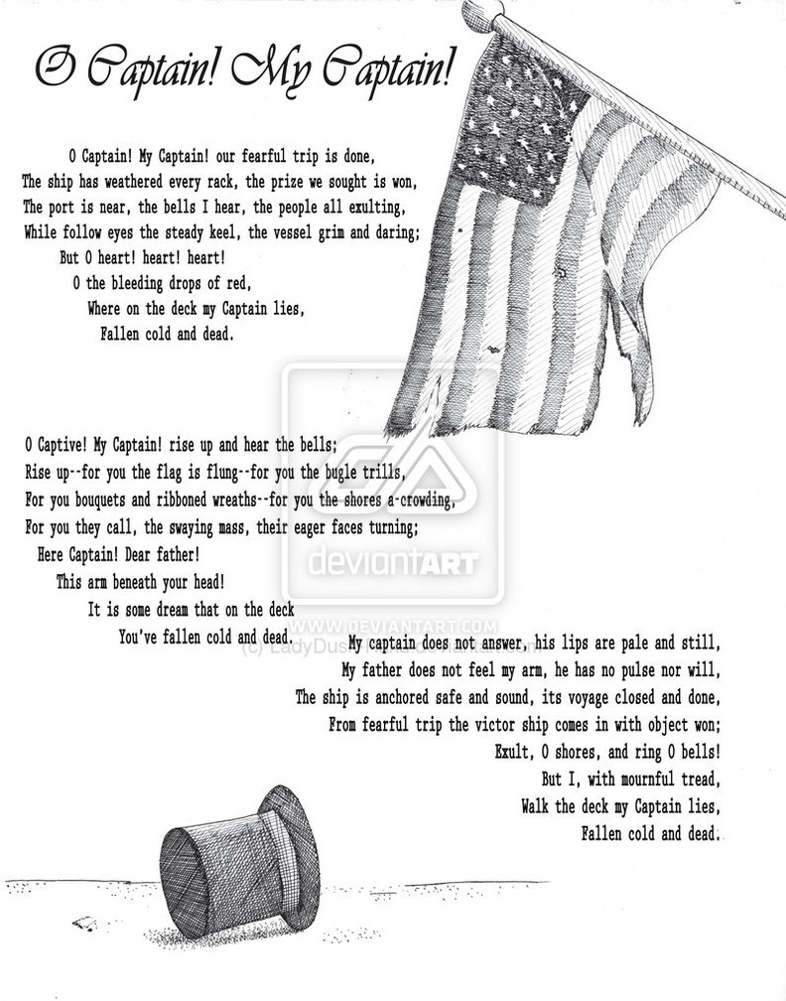

Slide 10
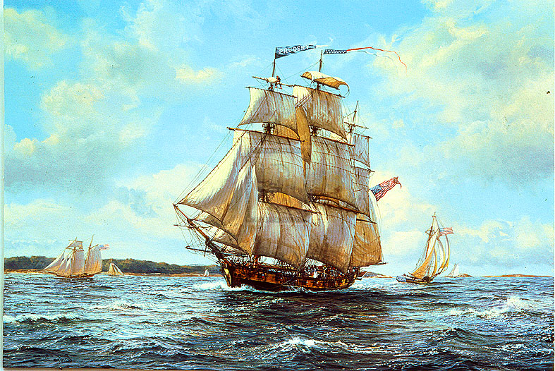
O Captain My Captain
Who might be the Captain in this poem; Why is he compared to a captain of a ship?
Where do you see apostrophe?
How does Whitman render the loss of ‘the captain’ as a loss personal to the speaker of the poem?
What are some of the words, phrases and poetic devices that give the reader a feeling of loss and mourning?
What is the theme of this poem?

Slide 11
Closure:
REALISM POP QUIZ TIME usual quiz procedures drop it in your class tray when you are done!
Tomorrow we will be going to the Media Center to work on grad papers!
Some common issues I have seen when grading….
This is a research paper so you need tones of quotes/paraphrasing….60% research 40%your clarification of the ideas.
Since it is research should there be any I, you, me, or we?
Numbers unless they are over one hundred you should spell them out like this not like 8…it looks less educated…
Any questions?

