Slide 1
Post modernism

Slide 2
Warm up:
What do you think post modernism is?
What themes do you think will be shown through this literature?
http://youtu.be/lKomOqYU4Mw

Slide 3
Modernism
We’re moving out of a time period where literature can be easily classified.
Writers become increasingly personal and further break down barriers of what is and is not literature.
Broadly, writers become increasingly cynical in the wake of some key events of the 20th century.
Beginning around 1940, what are some key events that shaped modern life?

Slide 4
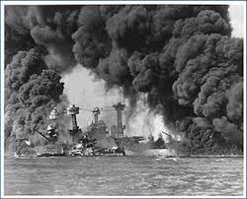
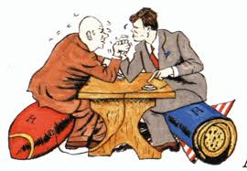
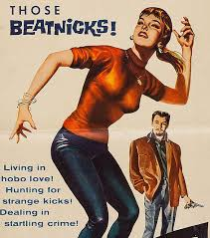
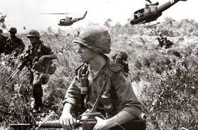
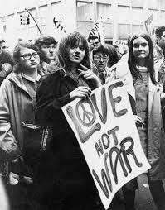
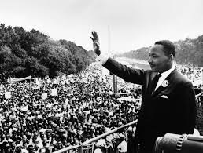
Historical events that shaped Contemporary Literature!
Pearl Harbor
Holocaust
Cold War
Vietnam War
Civil Rights Act/Civil Rights Movement

Slide 5
What is art?

Slide 6
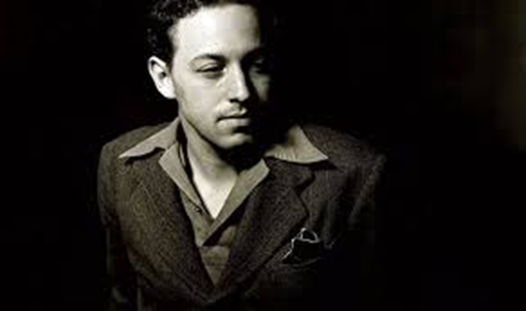
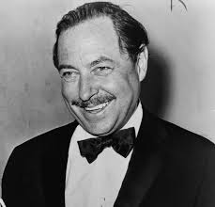
Tennessee Williams and Streetcar
Thomas Lanier Williams III in Columbus, Mississippi, in 1911.
Nicknamed “Tennessee” in college owing to southern accent.
Dad drank heavily and family moved constantly.
Williams loathed his father but grew to appreciate him somewhat after deciding in therapy as an adult that his father had given him his tough survival instinct.
Sick as a child.
Developed into a writer early. Read eagerly.

Slide 7
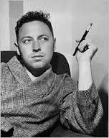
Life, characters
Alcoholism, depression, thwarted desire, loneliness, and insanity were all part of Williams’s world.
His experience as a known homosexual in an era unfriendly to homosexuality also informed his work.
Put much of his own emotions in female characters.
Male characters are often rough and animal-like and likely modeled after his father.

Slide 8
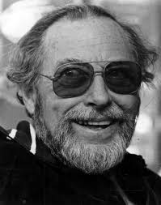
Writing style and death
Most plays are set in the south.
They examine the relationships between people.
Realistically examines sexual and emotional relationships.
Fell into a depression after the death of his partner in the ‘60s.
Plays fell out of favor as he failed to change with the times.
Died in ’83. Choked on a medicine bottle cap (alcohol related).

Slide 9
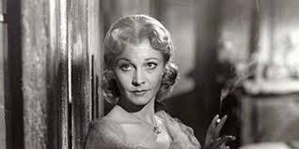
Blanche DuBois
School teacher.
Lost family plantation (Belle Reve) and moves to New Orleans to live with her sister.
Is having a nervous crisis.
Tries to pretend like it’s not happening.
Wants to desperately to give off a good appearance.

Slide 10
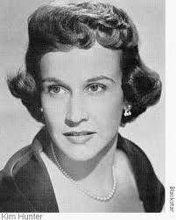
Stella Kowalski
Blanche’s sister.
Left Mississippi before the family fell into ruin.
Married Stanley Kowalski.
Stella’s marriage with Stanley is both animal and spiritual, violent but renewing.
Ignores Stanley’s violent streak and forgives his temper.
Pregnant.

Slide 11
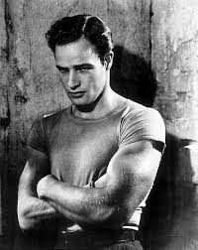
Stanley Kowalski
Loyal, passionate, violent.
Given to extremes.
Practical. Working man. No imagination.
Sees things as they are.
Fought in WWII.
Often described with animal terminology (he’s a bear, a brute).

Slide 12
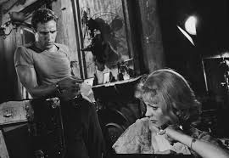
Reading Streetcar
Keep the study guide handy.
We’ll assign parts and change them up as we go.
I’ll stop periodically to discuss, and we’ll review at the end.
Parts for Today: (Scenes 1-2!)
Stanley
Stella
Eunice

Slide 13
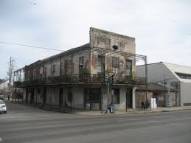

Slide 14
