Slide 1
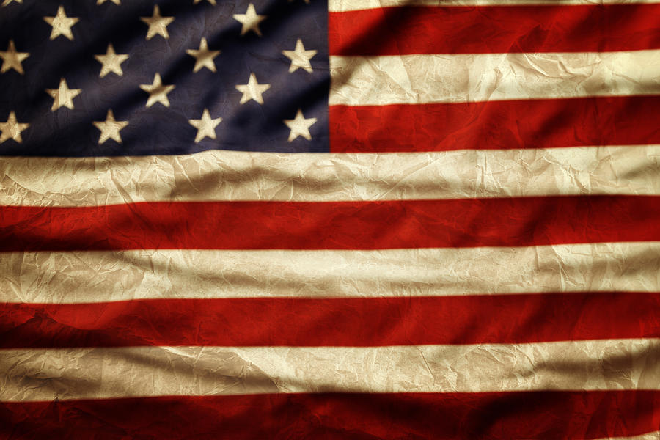
What is more important to Americans?
Our Freedom and our liberties OR working hard and achieving our dreams?

Slide 2
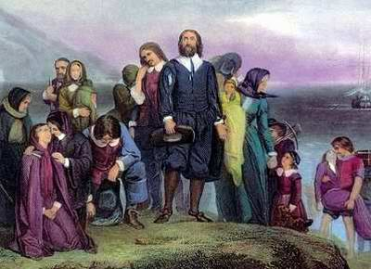
Puritans 1600’s America
Group of English Protestants who sought to“PURIFY” the Church of England
They wanted to
Worship simply and freely
So they left England for
Religious Freedom!

Slide 3
Beliefs
The Puritans believed that the Bible was God's true law, and that it provided a plan for living.
Humans were inherently evil
God’s wrath and Hell were real
Hard work and responsibility were important to please God
Witchcraft was evil and from the devil

Slide 4
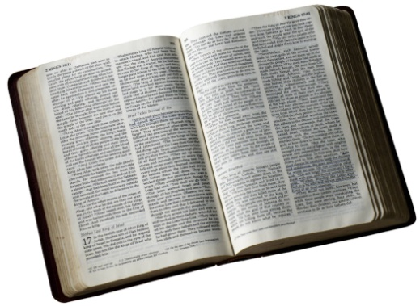
Predestination
PREDESTINATION-
  One cannot choose salvation, Only God alone can choose one’s fate.
Predestination kept all Puritans constantly working to do good in this life
They didn’t know if they had been chosen by God.
The Protestant work ethic was the belief that hard work was an honor to God which would lead to a prosperous reward.
“Signs” would give you a hint as to your predestination

Slide 5
Pre-destination
I’m a Puritan farmer.
Moo.
I’m a pretty rotten guy.
I drink and gamble; I’m nasty to my wife and kids.
But my farm is bounteous and profitable.
Every market day, I sell all my healthy crops.
Even though I’m a nasty guy, God must like me because my crops are healthy and I’m successful.
Clearly, it has been predetermined that I should be saved and go to heaven.

Slide 6
Pre-destination
I’m a different Puritan farmer.
Bah.
I’m a pretty decent guy.
I don’t drink; I don’t gamble.
I read the bible like all the time and treat my wife and kids well.
But my farm is a shambles. The crops are dying, the sheep don’t . . . um do whatever sheep are supposed to do.
And I’m poor.
Clearly, God doesn’t like me. It’s been pre-determined that I’m not going to heaven.
And there’s nothing I can do about it.
Rats.

Slide 7
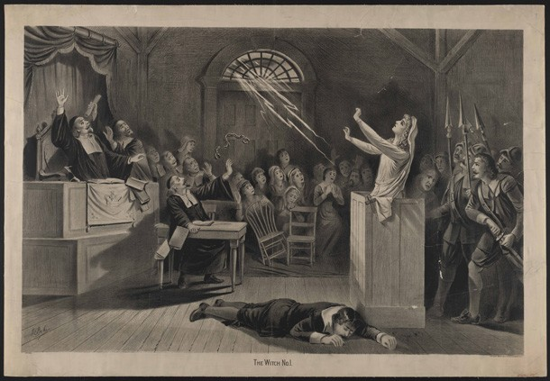
Salem Witch Trials
Puritan Community fell victim to the hysteria of the witch-hunt
20 people died by execution

Slide 8
Puritan Influence on Education
1635- Puritans formed the first formal school called the Roxbury Latin School.
1636- The first American College was established; Harvard in Cambridge.
By 1700, Boston became the second largest publishing center of the English Empire published Children’s Books First
The moral character of England and America were shaped by the words and actions of the Puritans.

Slide 9
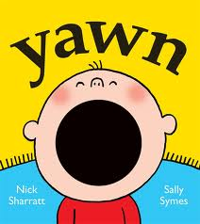
Puritan Plain Style:
Plain Style:
    Clarity
    Straightforwardness
    Simplicity
    Lack of ornamentation.
      (in churches, writing, etc.)
Wrote:
    Religious Tracts/Poetry
    Historical Documents
    Journals to analyze their Pre-Destination

Slide 10
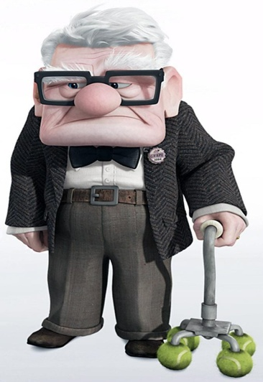
Puritans= To Grumpy Old Guy
Enlightenment thinkers who fomented the American Revolution would not get along with these guys.
The Puritans were suspicious, distrustful and superstitious.
But, it doesn’t mean they were bad people or that everything about them was negative in fact many US laws and morals are Puritan in nature.

Slide 11
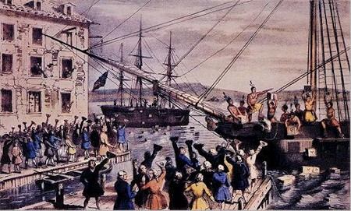
Enlightenment 1700’s
Questioned Puritans faith especially predestination and advocated for more personal freedom.
Governments should work for the people and provide basic rights and liberties to the people
Governments should be elected and represent people
No Taxation without Representation!

Slide 12
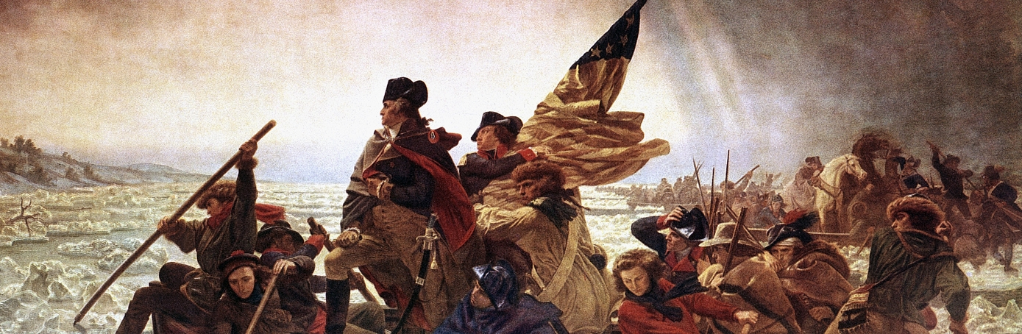
American Revolution
Great Britain tried to tax Americas and have tyrannical laws which led to American Revolution!
“ War of Ideas” newspapers, pamphlets, and speeches spread to awaken America to Independence

Slide 13
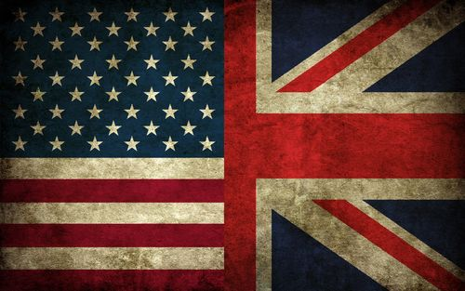
Enlightenment Writing Style
Persuasive: Full of Rhetoric and rhetorical devices
Usually meant to be given as a speech/ pamphlets in American Revolution
Sought to inspire others to join the cause and break up with England

Slide 14

So Enlightenment =Smart Parents of America
They helped to ensure religious freedom
Set up modern day democracy and elections
Challenged to have people use ideas and thoughts rather than blind faith!

Slide 15
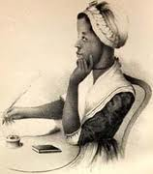
So let’s look at a Puritan Writer
Phillis Wheatley
First African American Poet Published (EVER!)
She was a slave, lived with Wheatley Family
Very well educated by Wheatley Family especially on religious text (Puritans)
Wheatley Family helped Phillis to publish her works
She is sometimes mocked for her somewhat ‘forgiving’ words on slavery…many of her poems talk about her special rights as a slave but also point out the immoral use of slavery

Slide 16
“On Virtue”
Complete the SOAPSTONE Worksheet and essay
Visual Representation: Wheatley Personified Virtue…. You will too! Mrs. Nickell will show you an example ☺

Slide 17
Virtue: Use your word for Virtue Here
Your Drawing Here
“Actual Textual Evidence from Poem to support your drawing”

Slide 18
Closure:
Puritans
http://youtu.be/N6szghAkEBA
http://youtu.be/4p-bWA1FOqs?list=PLFA79531CBA804D4E
We are going to Media Center Tomorrow!

