Slide 1
Realism

Slide 2
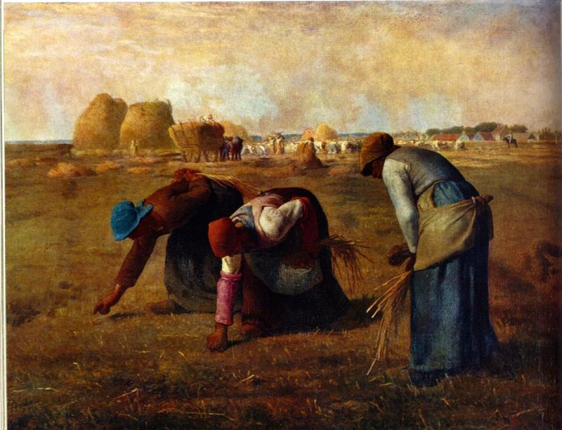
Realism
Came after all those crazy romantics generally taking place in the years 1865-1910.
Why? The romantics were interested in imagination and social change, the realist wanted to KEEP IT REAL!

Slide 3
What is Realism
Not interested in showing or exploring imaginary world- but want to show how the world really was.
The harsh bloody and brutal reality of the Civil War showed the country how rough reality could be!
Slavery was an issue many struggled with in the country and during realism we start to hear from the actual people who experienced it!

Slide 4
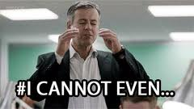
Tenets of Realism
People are portrayed as being manipulated by forces of society and nature beyond their understanding or control.
Man is basically an animal and will do anything to survive.
Man is an insignificant speck in the universe.

Slide 5
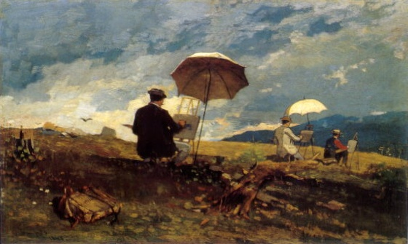
Tenets of Realism
Nature is an overwhelming force that controls a persons destiny
The prospects of life are determined by the accident of your birth and succeeding coincidences
God, if he exists, is indifferent to human struggle and human worth

Slide 6
Tenets of Realism
The odds of life are stacked against you
Man is ennobled to succeed in the face of such odds

Slide 7
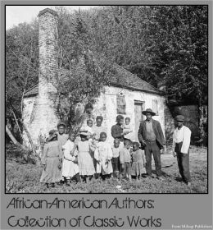
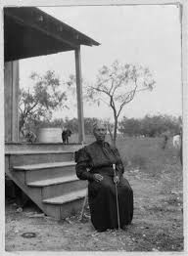
Slave Narratives
The purpose was to pull at American’s heartstrings to further the cause of the Civil War and abolition of slavery.
The audience was for actual slave owners and abolitionist to continue to fight the horrors of slavery.

Slide 8
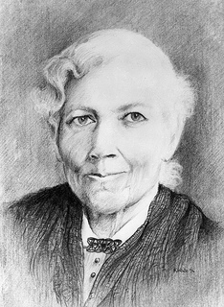
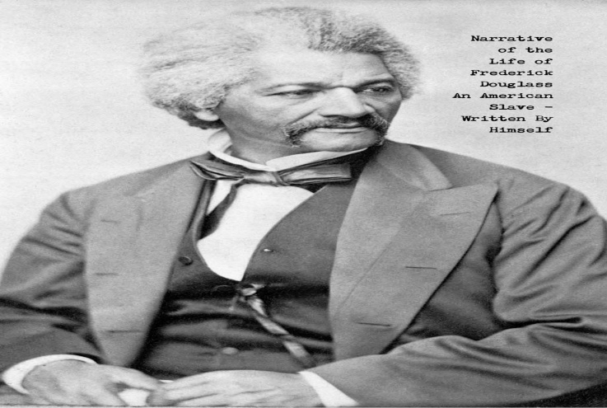
Slave Narrative Project
In a group to explore the lives of Americans who started their lives in slavery and were able to publish their narratives.
These stories require great respect as a nation and individual sharing them helps combat stereotypes, racism, and sexism that is still prevalent in this country!

Slide 9
Slave narrative Project Expectations
You will read the entire narrative! (yes…..) then you will summarize the major events into a slideshow
You will choose 3 quotes from the narrative that relate to the tenets of realism and explain
As a group you will design a presentation and research further information through the internet to gain insight into your narrator as well as background information on the time frame.
THIS IS A FORMAL GRADE FOR Q2

