Slide 1
Realism
Covers the years of 1855-1910
ALL ABOUT BEING REAL! They took the ideas of Romantics to portray real life issues.
Under Realism movement we have two types of writing styles
Regionalism- Capture customs characteristics and landscapes of a particular area includes local color
Naturalism – Reaction to wealthy few and rapid changes in society, humans are always in conflict with nature and its forces.

Slide 2
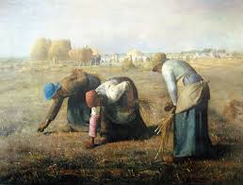
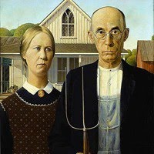
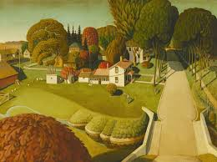
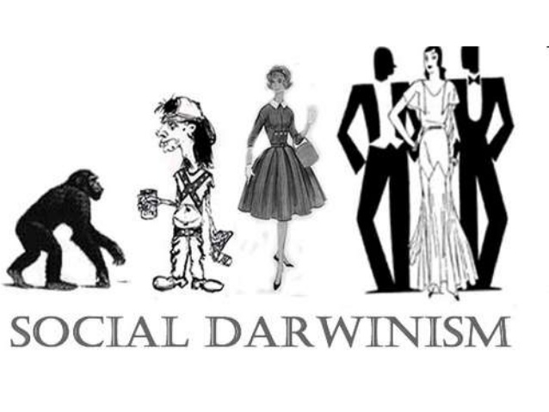

Slide 3
Writers of the time
Realism: Writers like Whitman, Dickinson, Lincoln, slave narratives show the time before and during the Civil War and the ordinary lives of Americans
Regionalism: To show the true South Mark Twain writes Huckleberry Finn celebrated as the first truly American Novel
Naturalism: To show the harsh realities and struggles in Chopin analyzed female points of view during this time

Slide 4
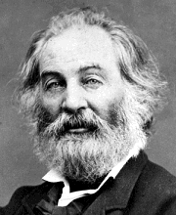
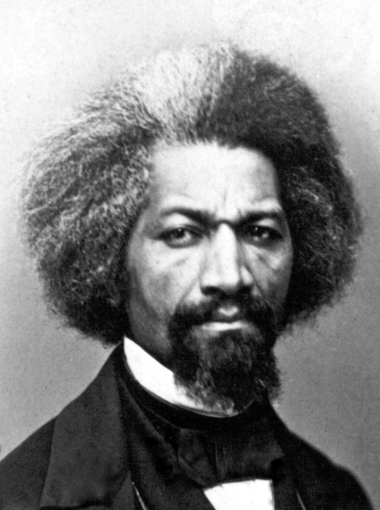
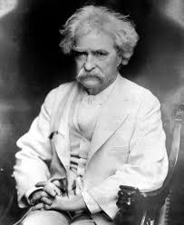
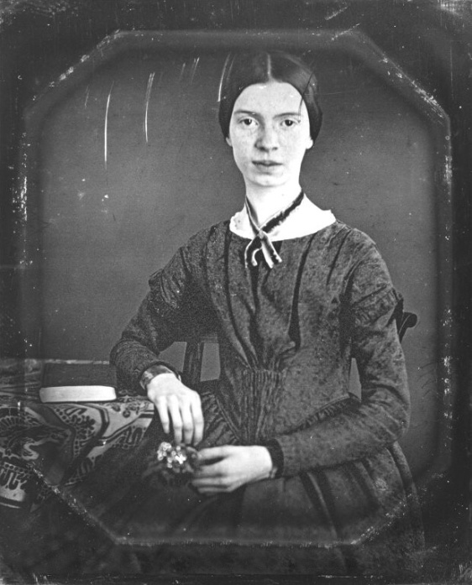
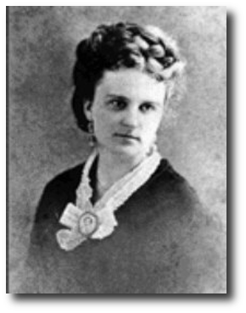
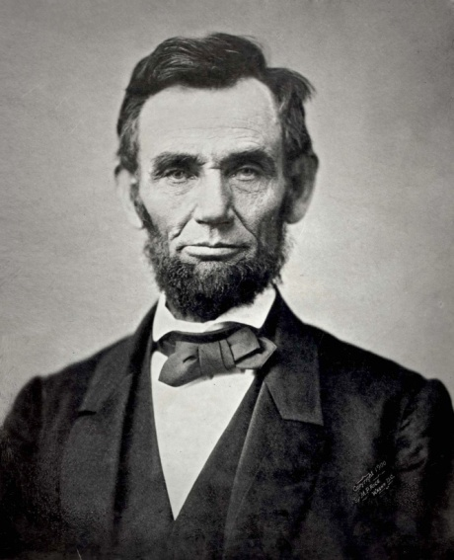

Slide 5
How did we get here?
Civil War left the south in ruins….RECONSTRUCTION was necessary. This was not an easy process.
After being torn apart many areas clung to their regional identities and started trying to capture the customs of their area in literature.
Local Color of areas shine true (Twain)

Slide 6
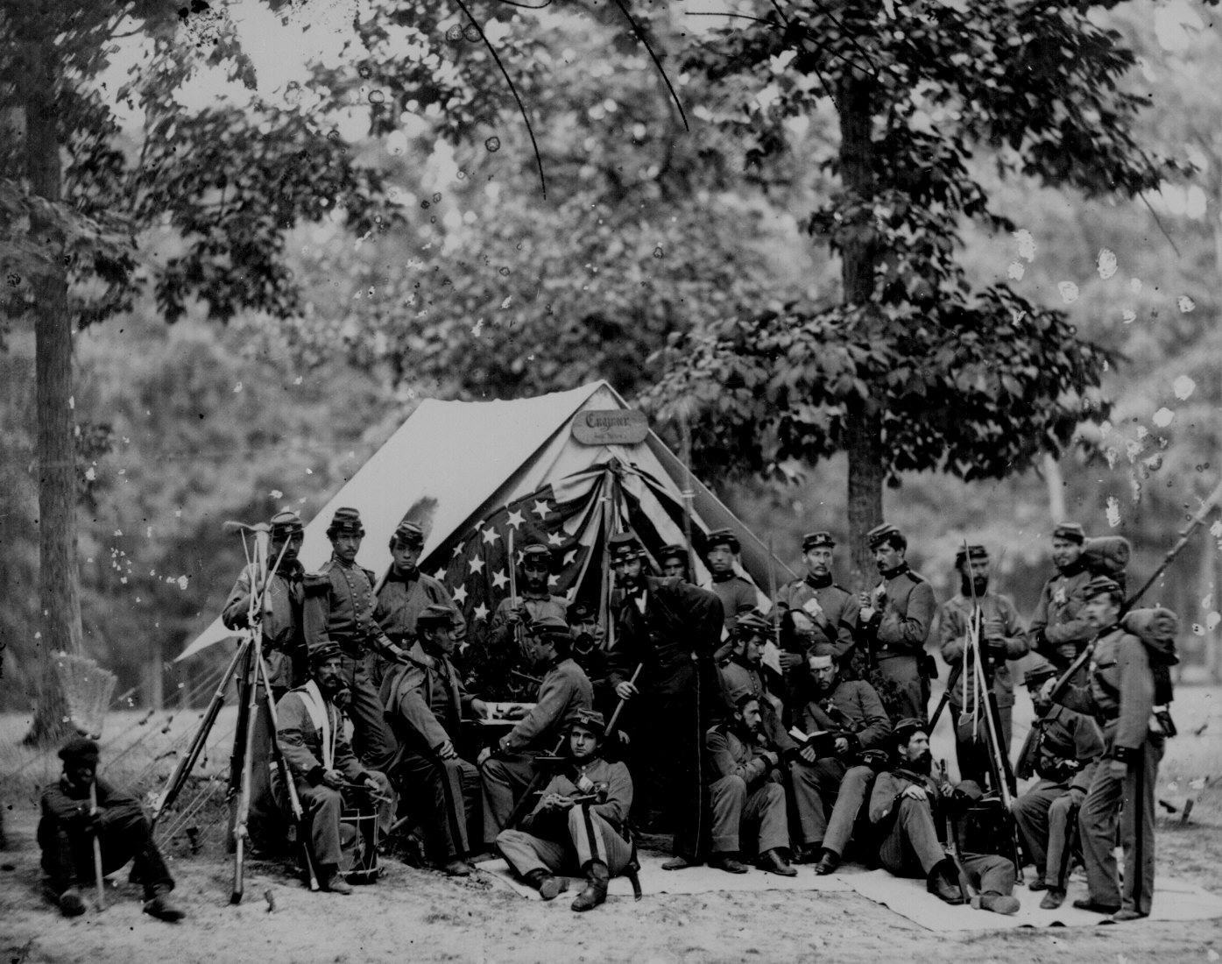
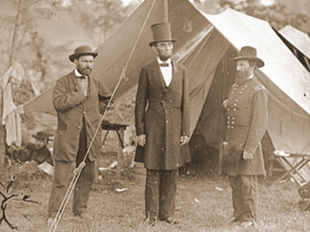

Slide 7
Transcontinental Rail Road- we have transportation from the Eastern US to Western US safely…..people start to move out west!
This movement created more diversity in areas due to an influx of Americans from all different areas converging to create a society.

Slide 8
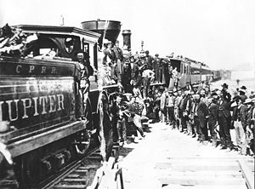
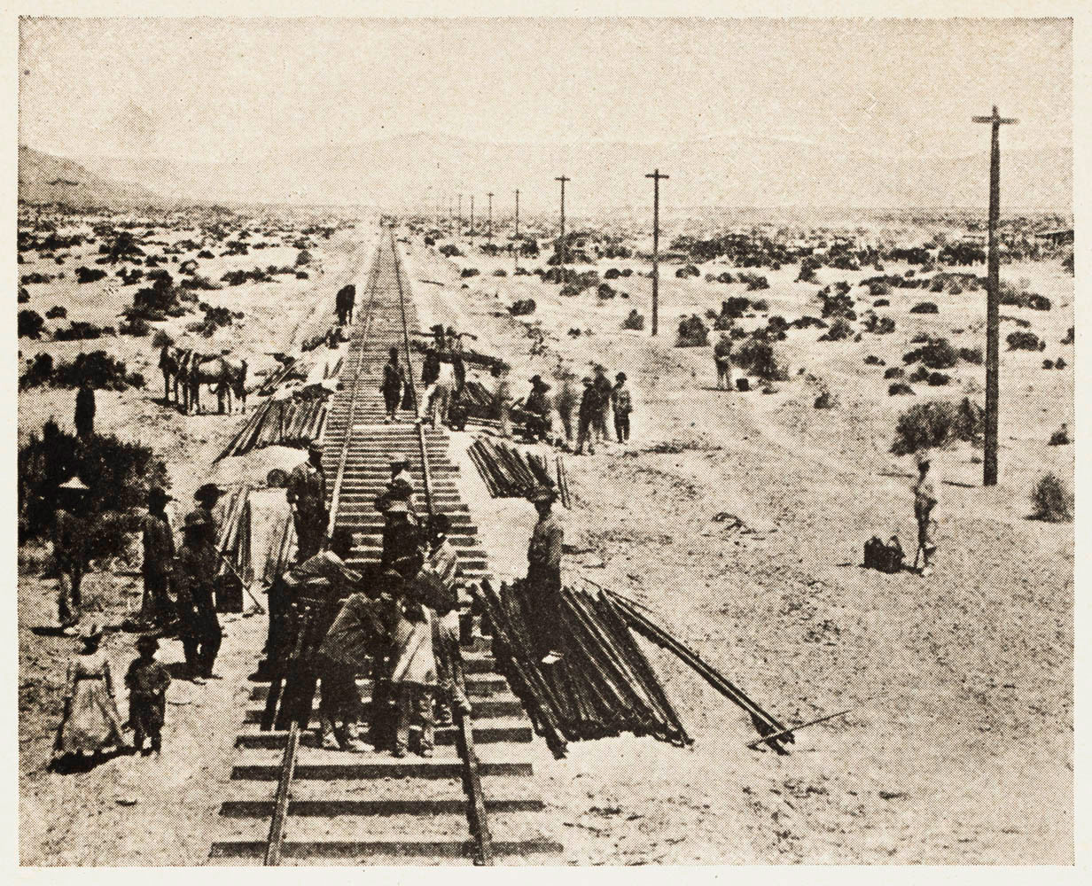

Slide 9
Though the US was growing in diversity and technology….wealth was only held by very few people.
This brought on THE GILDED AGE- which celebrated the decadence of the wealthy. For the first time we could now buy not make our goods (Sears Catalog)
“The time of sparkle, glitter, luxury, and excess”

Slide 10
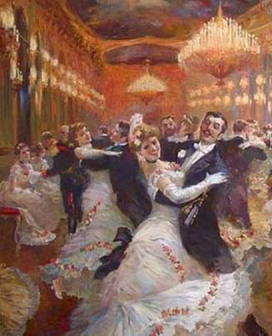
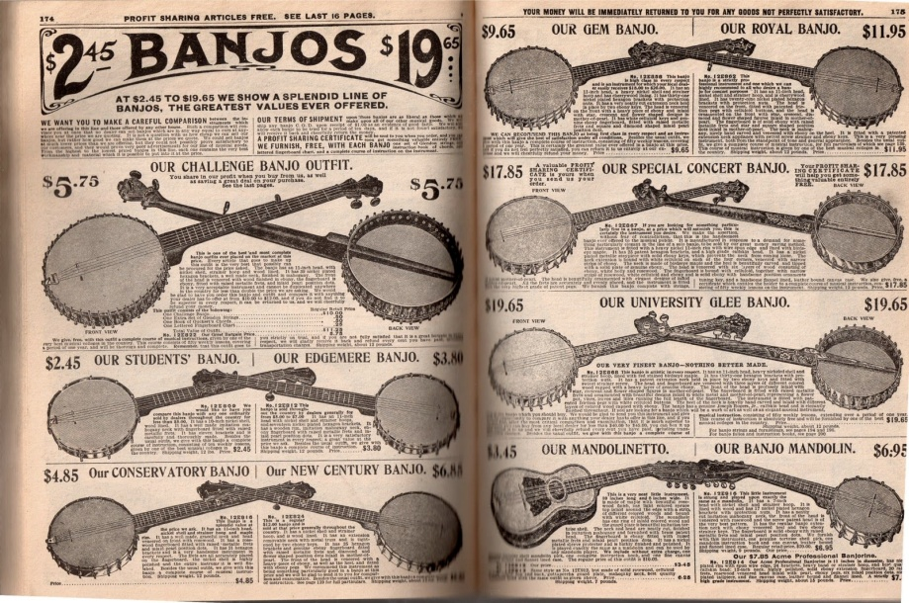

Slide 11
So if it was so ‘Gilded’ why was there realism?
Unfortunately not all people were included in the party.
Native Americans were being forced off their land in the West due to expansion
African Americans though now free from slavery many were still left poor and powerless and suppressed by Jim Crow segregation laws.
Immigrants were flooding the US searching for the dream only to live in poverty and work hard labor jobs in factories.

Slide 12
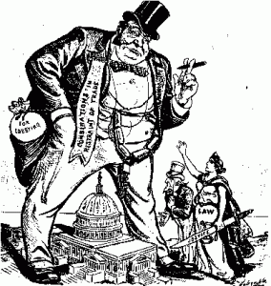
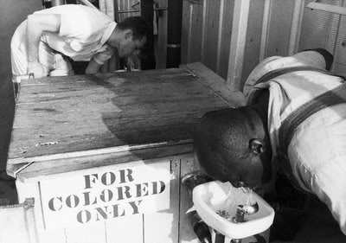
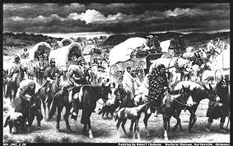

Slide 13
SOOOO since everybody was not living the life of luxury…
The naturalism movement came in to focus on the impact of social and natural forces on an individual.
Believed in Social Darwinism
Survival of the fittest (only those on top survive)
Laissez faire (not to regulate business practices)

Slide 14
