Slide 1
Before Bell: Please staple and turn in Self Bio paper to your class tray with RUBRIC attached! Get out your Vocab Books!!!

Slide 2
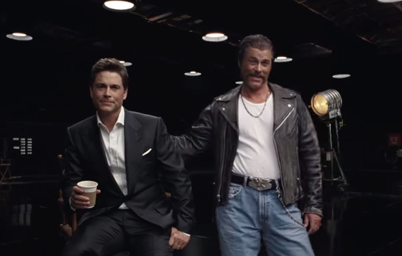
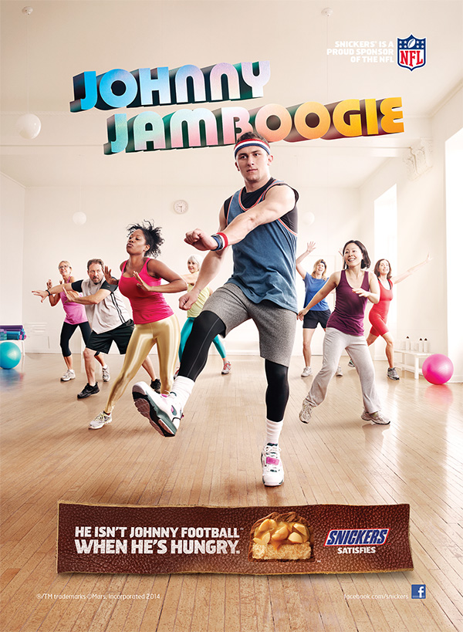
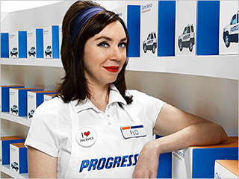
Warm Up: Advertisements
On a piece of paper reflect:
What type of advertisements do you see everyday? Who are they trying to sell to?
What is your favorite advertisement right now?
Why is it your favorite and how does it influence you?

Slide 3
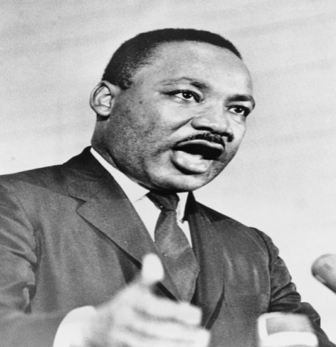
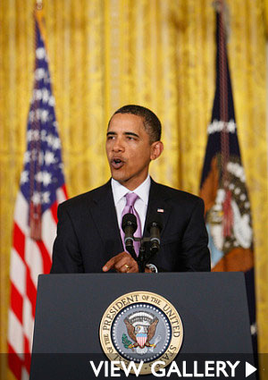
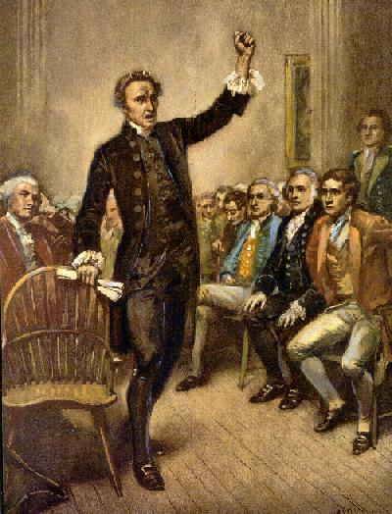
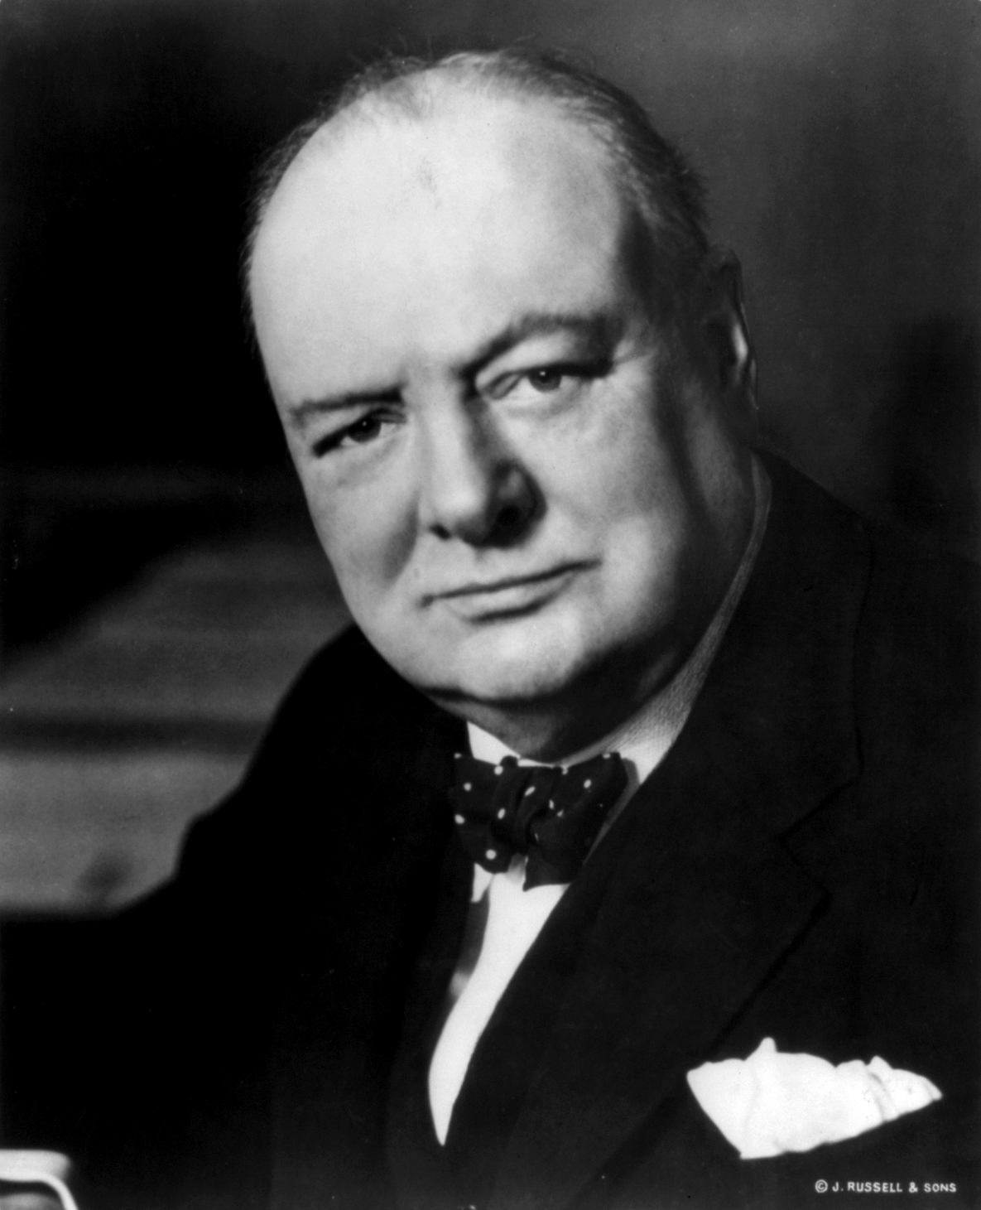
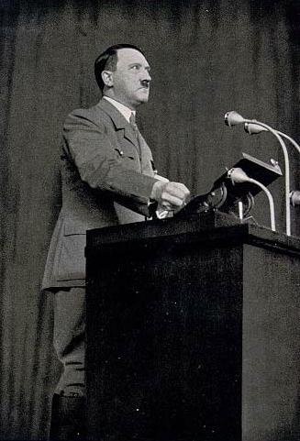
So What is RHETORIC?
Language used to convince or persuade an audience

Slide 4
3 Basic Persuasive Techniques
Logos-
Appeal to the Logic- Facts and data
Ethos-
Appeal through Credibility and moral character or ethics
Pathos-
Appeal to the Emotions

Slide 5
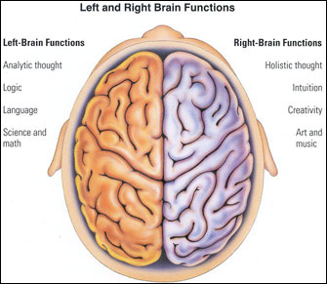
Logos- Is it Logical?
The appeal to the BRAIN using LOGIC, FACTS, and DATA Information to support the persuasive claim.

Slide 6
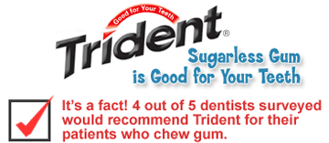
Ethos- Is it credible?
The Persuasive appeal based on the values, moral standards, and credibility of the person who is trying to persuade the audience.

Slide 7
Pathos- Is it Emotional?
A majority of arguments in the popular press are heavily dependent on appealing to your emotions.

Slide 8
See if you can figure out the Appeal
Gum
http://youtu.be/xAVALXH9nxU
Pepsi Commercial
http://www.youtube.com/watch?v=40DykbPa4Lc
Old Spice
http://www.youtube.com/watch?v=owGykVbfgUE
Sarah Mcglaughlin
http://www.youtube.com/watch?v=9gspElv1yvc
McDonalds
http://youtu.be/OtWRCIkFl00
Dove Commercial
http://www.youtube.com/watch?v=iYhCn0jf46U
Cheerios
http://youtu.be/aARf-XwDGFg?list=PL-Oprv9fueW2lG-LtaZbwe0WWkcncJTSU

Slide 9
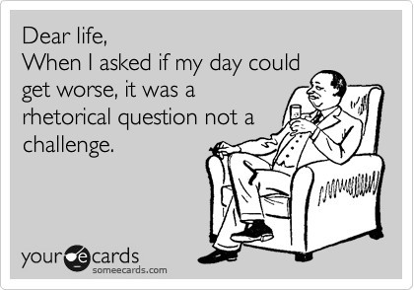
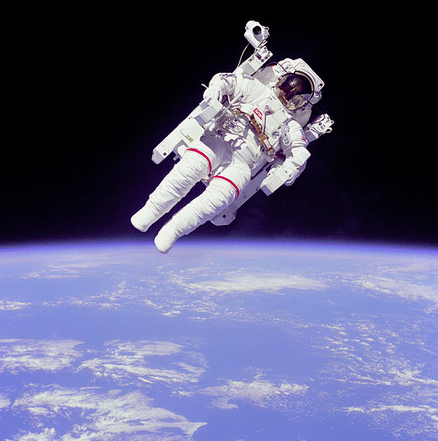
Rhetorical Devices..
Rhetorical question: obvious answer - “Should we be judged on appearance or rather the content of our convictions?”
Antithesis: Contrasting ideas are expressed in a grammatically balanced statement.
“One small step for man…one giant leap for man kind”
“Give me liberty or give me death”

Slide 10
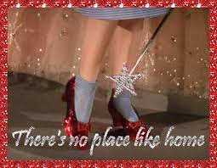
Rhetorical Devices
Repetition: Use of Same word or phrase for emphasis
Parallelism: A Pattern from line to line

Slide 11
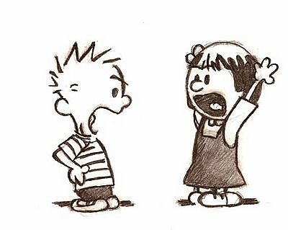
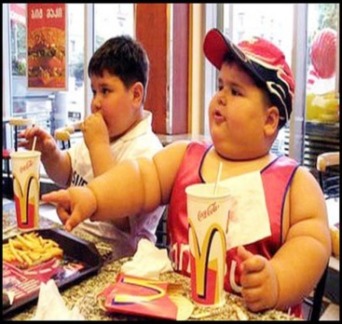
How to Make a Good Argument
A Claim- a clear statement of a position on an issue
Example: McDonalds is to blame for America’s obesity issue and the government should ban fast food.
Support- for the claim in the form of reasons and evidence includes these three elements
1.Grounds (Evidence)
Example: Obese children
2.Warrant ( Connection to evidence and your argument)
Example: Obese children cost the government money in healthcare.
3. Backing (Facts to back up your grounds and warrants)
Example: Because 58% of American children are obese it has caused health care cost to skyrocket

Slide 12
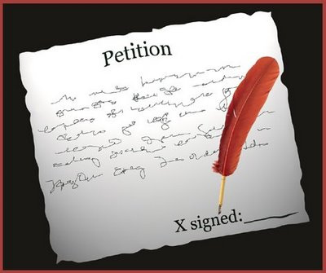
Counter Arguments- present the other opinion on your topic and then refute (why it is wrong) its claims.
Example: My peers may think HW helps with grades but I have found in not doing my HW I have increased my GPA.
Conclusion- that sums up the reason and call for action
Example: As stated HW is only a piece of the puzzle we must ensure the doing away of HW policies by signing this petition to present at the faculty meeting.

Slide 13
What is the claim?
Grounds?
Warrant?
Backing?

Slide 14
Let’s Practice help me fill in the blank…
Claim: RoyLee should be suspended.
Evidence: RoyLee cheated on his test.
Warrant: ???
Claim: ???
Evidence: ElRoy is very good at his job.
Warrant: People who are good at their jobs get raises.
Claim: LeRoy should do well on his test.
Evidence: ???
Warrant: People who study do well on their tests.

Slide 15
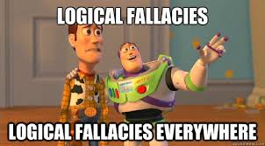
Things to Avoid
Fallacies &Errors in Logical Thinking…
Circular Reasoning- Supporting the Statement by Repeating the statement in different words
Hasty Generalization- A conclusion drawn from too little evidence or from evidence that is biased

Slide 16
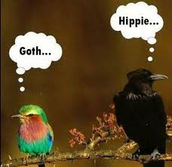
Fallacies to Avoid
Non Sequitur- A conclusion that does not follow logically from the “proof” offered to support it
Name Calling- Personal Attack
False Cause- Thinking something is the cause of something else-
Either/Or- Giving only two options-
Example: “you’re either with us or against us!”

Slide 17
Death Row Argument
1. Who is Roland Williamson? Who is Anthony Porter? Who is William Brennan?
What claim is the ad making?
What evidence do the ad-writers use to support their claim?
What is the purpose of this ad? What, in other words, did the ad-writers hope to achieve?
What are some possible objections or counterclaims that could be raised in responding to this ad? By whom might these objections and counterclaims be raised?
Finally, hypothesize whether or not the claim is effective for the intended audience and why it might be?

Slide 18
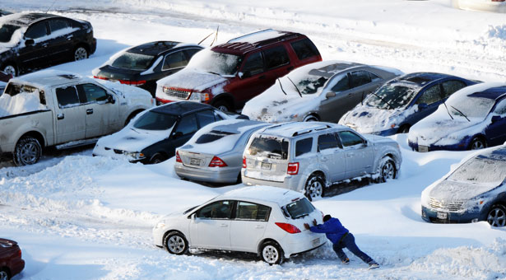
The Parking Ticket
You work at Carolina Place Mall. You’re working very hard saving money for college. On January 11, you went to work, despite a freak snow storm. You pulled into a parking spot, covered in snow. You return, 8 hours later to a melted parking lot only to discover your car has been towed. Upon investigation, you discover that the snow covered a handicapped parking spot with a picture and blue lines painted on the ground, but no sign. You paid $250.00 for the tow and have been given a $500 ticket.

