Slide 1
Bell Work
*Turn in any late work!
*Take out your Nature worksheets from yesterday, your piece of nature from HW, and your vocabulary Book!
*What words come to mind about your piece of nature? How would you describe it? How does it make you feel?

Slide 2
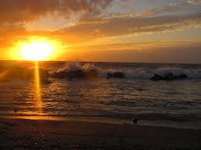
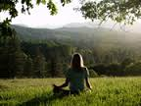
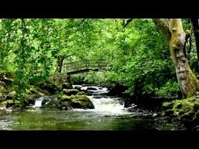
Warm up
Take out your piece of nature you brought for homework last night and a piece of paper
. Utilizing the tenants of Transcendentalism write a 7-10 line poem (choose any rhyme scheme you want) that reflects Emerson’s ideas from yesterdays passage “Nature”
Truth in nature and spirituality in nature, Interconnectedness of nature and humans, Individuality and Inner goodness of man, Simplicity/Self Reliance of man in nature
Utilize 2 vocabulary words from Unit 3 in your poem!
Didn’t bring something in….think of your favorite thing in nature
This is a contest the best poem will be rewarded in some way!
Yes you will be presenting this (Show and Tell Day!)

Slide 3
Annotation of Nature
Nature is a setting that fits equally well a comic or a mourning piece. In good health, the air is a cordial of incredible virtue. Crossing a bare common, in snow puddles, at
twilight, under a clouded sky, without having in my thoughts any occurrence of special
good fortune, I have enjoyed a perfect exhilaration. I am glad to the brink of fear. In
the woods too, a man casts off his years, as the snake his slough, and at what period
soever of life, is always a child. In the woods, is perpetual youth.

Slide 4
Nature
Within these plantations of God, a decorum and sanctity reign, a perennial festival is
dressed, and the guest sees not how he should tire of them in a thousand years.
In the woods, we return to reason and faith. There I feel that nothing can befall me in
life, — no disgrace, no calamity, (leaving me my eyes,) which nature cannot repair.
Standing on the bare ground, — my head bathed by the blithe (carefree) air, and uplifted into infinite space, — all mean egotism vanishes.

Slide 5
Nature
It is necessary to use these pleasures with great temperance. For, nature is not
always tricked in holiday attire, but the same scene which yesterday breathed
perfume and glittered as for the frolic of the nymphs, is overspread with
melancholy ( def: gloomy, moody) today.
Nature always wears the colors of the spirit. To a man laboring under calamity
(def: great misfortune), the heat of his own fire hath sadness in it. Then, there is a kind
of contempt of the landscape felt by him who has just lost by death a dear friend. The
sky is less grand as it shuts down over less worth in the population.

Slide 6
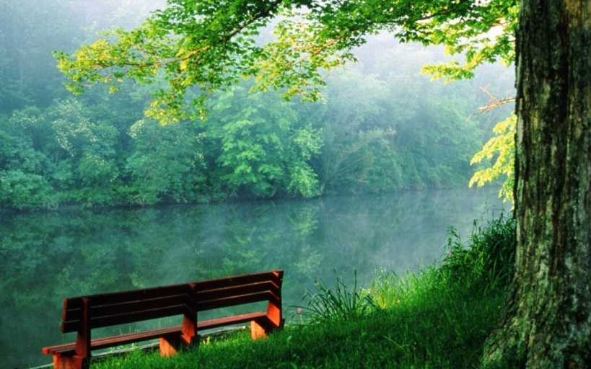
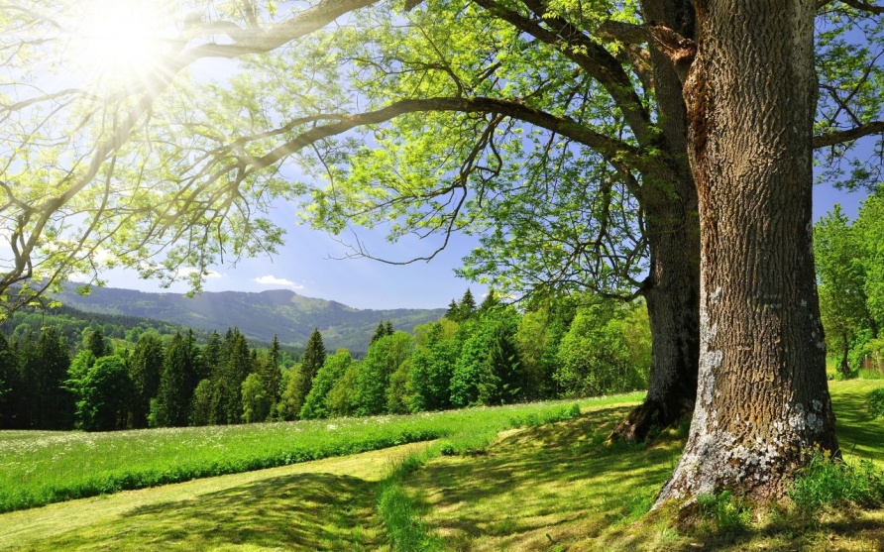
Emerson’s “Nature”
Why did he write this? What’s his point?
How do man and nature relate to each other?
What does Emerson mean when he says he becomes "a transparent eye-ball" (442)?
In what way does nature serve as a teacher?

Slide 7
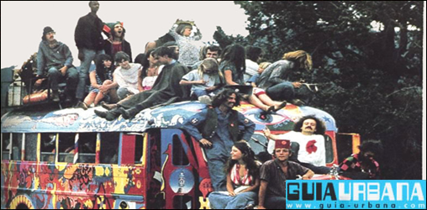
Nature review
Emerson is considered the father of transcendentalism, what about his nature essay do you think made people buy into this movement?
http://www.youtube.com/watch?v=m5k9x16yYGo

Slide 8
Self Reliance
Ralph Waldo Emerson

Slide 9
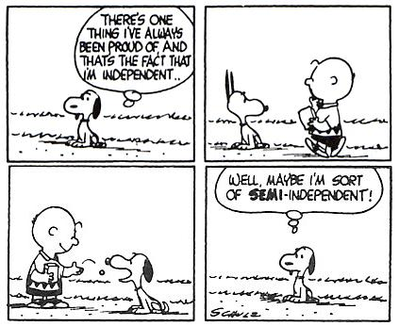
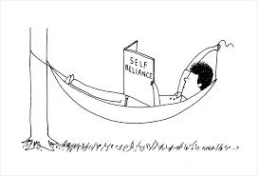
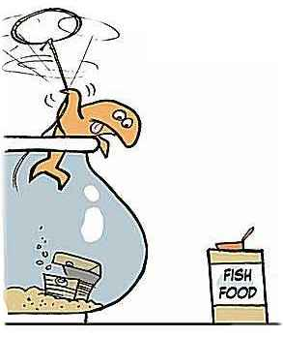
Self Reliance
What tenants of transcendentalism does this exemplify?
“Dead Poets Society”
http://www.youtube.com/watch?v=SnAyr0kWRGE

Slide 10
Self Reliance
“There is a time in every man's education when he arrives at the conviction that envy is ignorance; that imitation is suicide; that he must take himself for better, for worse, as his portion; that though the wide universe is full of good, no kernel of nourishing corn can come to him but through his toil bestowed on that plot of ground which is given to him to till.”
“Trust thyself: every heart vibrates to that iron string.”

Slide 11
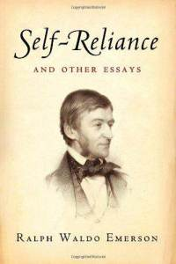
Self Reliance
Why does Emerson see society as the enemy of individuality?
What is the role of nonconformity? What did that word mean to Emerson?
How is trust a part of being self-reliant?

Slide 12
Nature and SELF RELIANCE
With a partner and create a graphic organizer with the following elements:
A summary of Self-Reliance
A summary of Nature
A comparison of the two essays
Elements of Transcendentalism found in both
We’ll discuss these as a whole class!

Slide 13
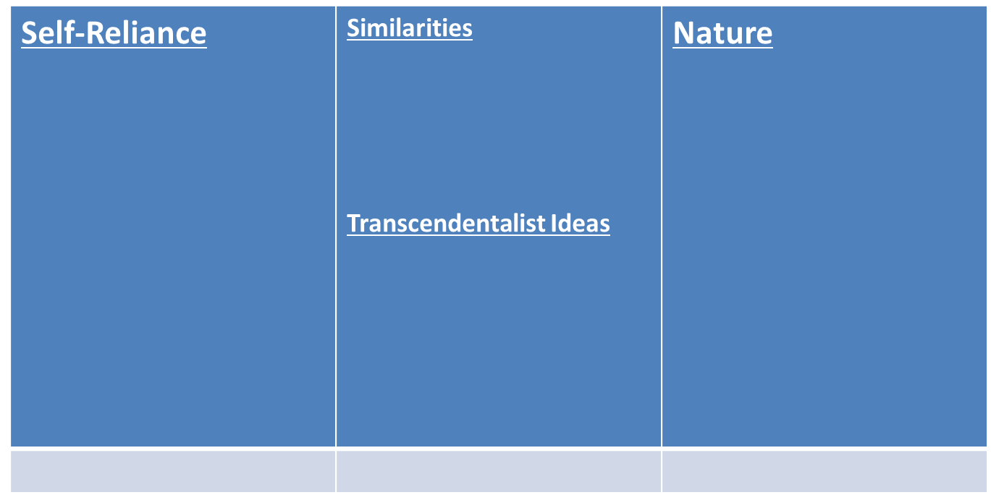
Foldable:

Slide 14
Closure
Read P. 366-367 using Self Reliance as your example of Emerson’s work
Complete the Art of an Essay worksheet with the text!

