Slide 1
Thanatopsis

Slide 2
Warm Up
Video
In your journal reflect on the video with the following questions:
What do you think happens to us in the afterlife?
What is most important living a good life or living a long life?
What is the legacy you hope your generation leaves behind?
http://youtu.be/72NELwSeafk

Slide 3
Thanatopsis
The Greek root thanatos means death.
The Greek word opsis means sight.
So what is the title telling us?

Slide 4
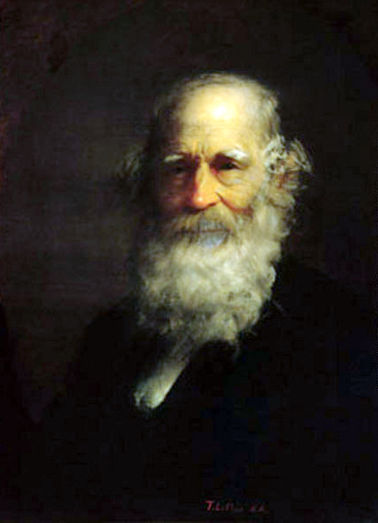
Romanticism
William Cullen Bryant: YOLO. Really. That’s about it.
Though written at the age of 17, WCB edited the poem 10 years later, adding the final 9 lines.
Do you think his youth is part of how he is viewing death at 17? How do you account for the change? How might he have rewritten it 20 or 50 years later?

Slide 5
Blank Verse
Unrhymed poetry written in iambic pentameter.
Each line has five iambic feet, a pattern consisting of an unstressed syllable ( ) followed by a stressed syllable ( ).
Poets who write in blank verse sometimes vary this rhythm, using loose iambic pentameter to add a conversational tone.

Slide 6
Structure
In poetry, structure is the arrangement of words and lines to produce a desired effect.
Summarize each section to understand the content and central ideas.
Look for details and word choices that convey mood.
Section | Idea | Mood | Diction | Tone
1st | Death comes to everyone | Bleak

Slide 7
Analyze together
To Him who in the love of Nature holds communion with her visible forms, she speaks
A various language; for his gayer hours
She has a voice of gladness, and a smile
And eloquence of beauty, and she glides
Into his darker musings, with a mild
And healing sympathy, that steals away
Their sharpness, ere he is aware. When thoughts a
Of the last bitter hour come like a blight
Over thy spirit, and sad images
Of the stern agony, and shroud, and pall,
And breathless darkness, and the narrow house,
Make thee shudder, and grow sick at heart’ –
Go forth, under the open sky, and list

Slide 8
Partner Work
In your group work to fill out the worksheet questions for each section and for the figurative language found in the poem.
This will be placed on your assignment tracker!

Slide 9
closure
With which of the following statements would Bryant agree?
Worship should only take place inside a church.
City life is superior to country life.
Humanity lost something vital as it moved to an industrialized world.
Evidence of a divine being can be found in nature.
Homework:
1.) Grad Paper Notecards/Bib due Thursday
2.) TSL QUIZ 9-17 Wednesday

