Slide 1
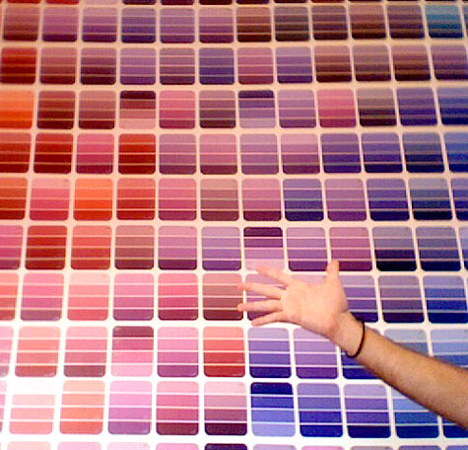
Before the bell
Turn in your Thomas Paine 5 question quiz page to me upfront in your blocks tray!
Grab only 1 paint chip strip from upfront

Slide 2
Warm Up:
Grab a paint chip from up front (JUST 1!)
Utilizing the darkest color as strongest(closest) word and lightest color as weakest(distant) word place these words on a paint strip:
Love, admire, adore, like, affectionate
Hate, despise, indifferent, abhor, loathe
Friend, lover, spouse, enemy, stranger

Slide 3
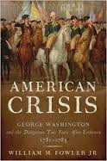
Thomas Paine “The Crisis”
The Enlightenment!

Slide 4
Let’s review last night’s reading… p. 250 in our books
What two qualities does Paine say American Troops need to win the war?
What is his proof that the American’s should support the war?
What literary device is summer soldier?
What is the tone of this passage?

Slide 5
Answers
What two qualities does Paine say American Troops need to win the war?
Perseverance and fortitude
What is his proof that the American’s should support the war?
They tried everything they could before the war. God would not favor the cause of a murder such as the king
What literary device is summer soldier?
Alliteration
What is the tone of this passage?
Fiery, emotional
Tyranny, glorious, triumph,

Slide 6
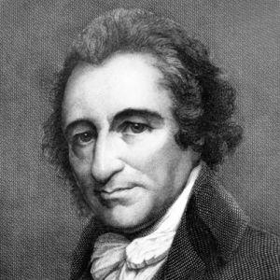
Thomas Paine
The Enlightenment Age (We are more logical and smart than those old Puritans!)
The American Revolution Warrior T. Paine
Famous for his pamphlets/propaganda in the American Revolution
Much of his writing attacked the injustices imposed on Colonist and to seek independence
“Only the law is king”

Slide 7
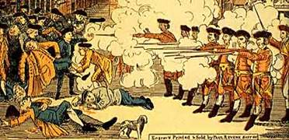
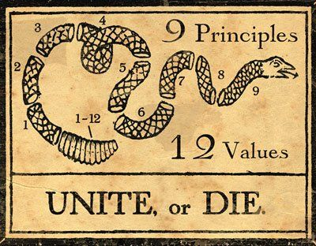
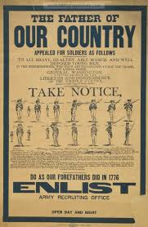
American Revolution Propaganda

Slide 8
Let’s help spread Paine’s word!
Place yourself in groups of 2-3 people no more than 3! (4 is more than 3!!!!)
Lets make our own Pamphlet
You will need to tri-fold a piece of paper that means their should be 3 sections when you open it! (Look at my example!)
Nominate one group member to grab 2 sheets of paper for your group and an instruction sheet!

Slide 9
Paine Pamphlet instructions
On the front: Should be “The Crisis” title and a short 2-3 sentence summary of the piece followed by an artistic rendering.
In the inside each fold should have Ethos, Logos, Pathos headings and appeals that are found with in the speech (Cite the text you need 2 examples of each!)
On Back place Thomas Paine’s Claim and evidence on one section
Very Back Counterargument and defeat of counterargument

Slide 10
Create your own Pamphlet
Using the same template as Paine’s pamphlet your group will declare its own “independence” choose one:
Independence from school rules
Independence from family rules
Independence from organization etc. rules
You must logically, emotionally, and ethically prove your argument and dismiss the counterargument (your evidence and support can be fictional but must still be there!)

Slide 11
Closure
Groups to present their argumentative findings and own propaganda!

