Slide 1
Civil Disobedience

Slide 2
Before the Bell!
Turn in your Article of The Week
Have a piece of paper out from Warm Up section ready to go for Warm Up Video and copy down these questions!
What outcome do the student’s want to accomplish?
Why do you think they are choosing to protest in this way?
Is this effective in sending a message?
What do you think about it? Do you agree? Disagree?

Slide 3
Article of the Week Discussion
https://www.youtube.com/watch?v=toBNkOsJUaA
What outcome do the student’s want to accomplish?
Why do you think they are choosing to protest in this way?
Is this effective in sending a message?
What do you think about it? Do you agree? Disagree?
Tell me about a time you stood up for something you believed in!

Slide 4
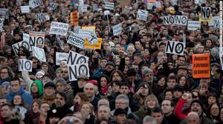
Circle- Discussion
Discuss what you wrote with 3 different people.
Listen to what they have to say!! Then rotate!
Ask any other questions that you’d like to know about Government/Peaceful Protest/etc.

Slide 5
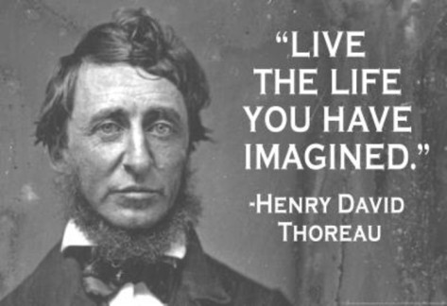
Mr. Henry David Thoreau

Slide 6

Thoreau
Emerson was more the THINKER
Thoreau was the DOER!
He LIVED OUT what Emerson was stating about connecting with nature and living the simple life he lived in isolation and nature for TWO WHOLE YEARS on Walden Pond!

Slide 7

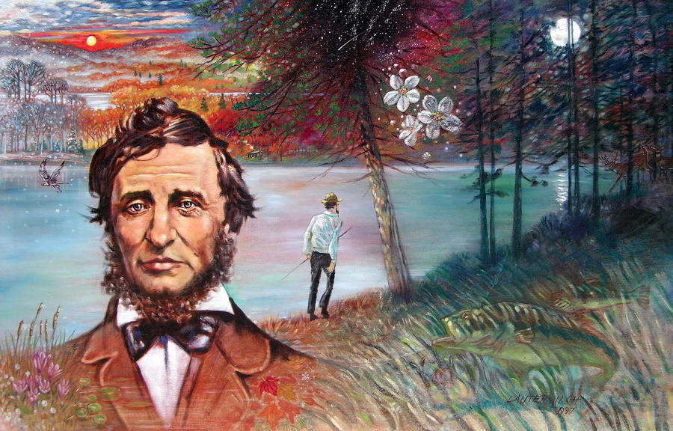
Total ISOLATION?
Yep.
That was Thoreau’s Life.

Slide 8
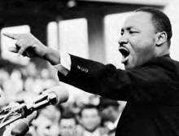
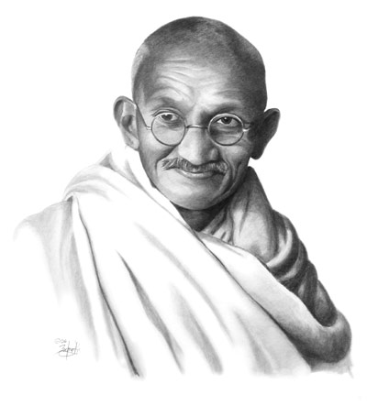
Thoreau followed THROUGH!
Impacted Martin Luther King, Jr. and Gandhi to take stands against the government
Peaceful Protest
Stand up for your
individual rights

Slide 9

CIVIL DISOBEDIENCE
Reading Group Activity!
You will be in GROUPS: Each person will have a ROLE!
1st you will READ your Assigned Section You will each be responsible for highlighting and TEACHING what you’ve found to your GROUP.

Slide 10

ROLES
A- Highlight Transcendentalist THEMES
B- Highlight Rhetorical Devices: antithesis, parallelism, repetition
C- Highlight- Logos, Ethos, Pathos, Rhetorical Question
D- Highlight figurative language (metaphor, simile, paradox) and Vocabulary in Context- Meaning you must look up words you don’t know and write down the definition and explain how it affects the context.

Slide 11

TEACHING!
Ok so now lets get in groups!
You will TEACH your GROUP one at a TIME about what you found (This is by number so groups 1 A-D, 2 A-D, 3 A-D there will be two groups for each number!)
Everyone in the GROUP must discuss with you-respond-answer-mark on their own reading your examples!
Then you rotate to the next person!

Slide 12

Pop Culture Closure
http://www.azlyrics.com/lyrics/blackeyedpeas/whereisthelove.html
What specific things are wrong with the world according to this song?
What is the message this song reflects about about the government?
According to the song, what is the solution?
What are your thoughts about the government today?
What rights do people have?

Slide 13
Before the bell
Have a sheet of paper out in your warm up section ready to go!
Take a look at the HW!
Be prepared to work on TSL seminar/essay and your Grad Paper tomorrow in class…USB, Laptops, Books are all very helpful!

Slide 14

Warm Up
Choose one of these famous quotes
Now analyze it, explain the significance to the class and then express how it fits into Transcendentalism ideals:
  Non-Conformity/Individuality
  Civil Disobedience
  Simplicity in life
  Nature and its interconnectedness to spirituality

Slide 15
Civil Disobedience Quotes
“One has a moral responsibility to disobey unjust laws.”
― Martin Luther King Jr.
“It is not always the same thing to be a good man and a good citizen.”
― Aristotle
“Protest beyond the law is not a departure from democracy; it is absolutely essential to it.”
― Howard Zinn
“An unjust law is itself a species of violence. Arrest for its breach is more so. Now the law of nonviolence says that violence should be resisted not by counter-violence but by nonviolence. This I do by breaking the law and by peacefully submitting to arrest and imprisonment.”
― Mahatma Gandhi

Slide 16

What do you THINK?
What are some ways that you have seen CIVIL DISOBEDIENCE throughout history?
Choose a specific event and explain why the event was significant.

Slide 17
Civil Disobedience Review Questions
How did Thoreau live out his message of Civil Disobedience. Describe what specific events inspired him. Explain the significance of his lifestyle in connection to his writing.
What were 3 main points that Thoreau made in your section? Do you agree with him? Why or Why not?
What was his purpose for writing this piece? What is his tone?
Choose one quote that sums up the topic of your section. Explain its significance.

Slide 18
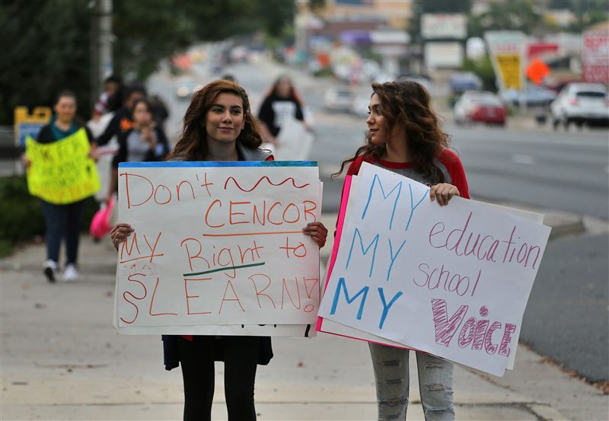
Make a Poster
With your Group- You will make a POSTER on your SECTION. You will find specific lines that demonstrate the Theme of Transcendentalism and Non-Conformity through Civil Disobedience
You will take those lines out of the text- Write them out and then Explain them for the class…IN YOUR OWN WORDS! (Paraphrasing!)
You also need a specific visual image for your section as well.

Slide 19
Poster Requirements
TITLE your section based on what it is specifically referring to (You create this! What could it be called on it’s own?)
PICTURE- to represent the theme or topic COLOR is a big help!
LINES- Choose 2 lines that are specifically related to the theme of Transcendentalism write them out and then TRANSLATE THEM- explain their significance and how it relates to the theme.
RHETORIC-Identify 1 line in your section that utilizes ethos, logos, or pathos write it out and state why it is one of these rhetorical appeals.
FIGURATIVE LANGUAGE-Identify 1 use of parallelism, metaphor, simile, or repetition and state its impact on the section (Why Thoreau used it!)
TONE-As a group identify the tone of your section and state 3 diction choices that led you to this choice!

Slide 20

Gallery Walk
As you walk to each section notice their choices and summaries, quotes, and ideas
From EACH poster your group should create 1 question you want answered or feel could be asked of you on a test
Place this question on a post it note and then move to the next poster till you see them all!

Slide 21

Closure
Now you are back at your poster. Take a look at all the questions left for your group.
Identify one question you would like to discuss/answer and have elect one group member to read it to the class! This means do not repeat the same questions from other groups so have a couple of options!

