Slide 1
Bell work turn in any late work take out your Emerson notes you printed for HW START choosing right word vocab unit 3

Slide 2
Warm Up
VOCAB CHOOSING THE RIGHT WORD 1-15 ☺
http://www.youtube.com/watch?v=f4vkq2ztxSw
How does this exemplify the ideals of transcendentalism?
What specific song lyrics stand out to you?
http://www.youtube.com/watch?v=6HuqNdQJSTY
What ideal does this exemplify in transcendentalism?
What specific actions represent a transcendentalist thought?

Slide 3
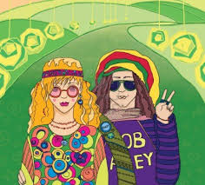
Key Ideas of Transcendentalism
Emphasized living the simple life
Stressed a close relationship to nature (We Find Truth here!)
Celebrated emotions and the imagination
Stressed individualism and self-reliance (Non-Conformist)

Slide 4
Transcendentalists
Believed intuition can lead to knowledge
Believed in the inherent goodness of people
Encouraged spiritual well-being over financial well-being
CRITICIZED:
The Puritan heritage
The commercial and financial side of American life
People’s lack of focus on Spirituality

Slide 5
Transcendentalists
Wanted to TRANSCEND- or go beyond- the limitations of the everyday experience
Led by Emerson himself He is considered the father and his Thoreau went out and actually performed his ideals.
Key tenets are listed on your worksheet activity

Slide 6
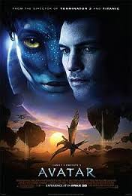
Pop Culture Examples of Transcendentalism

Slide 7
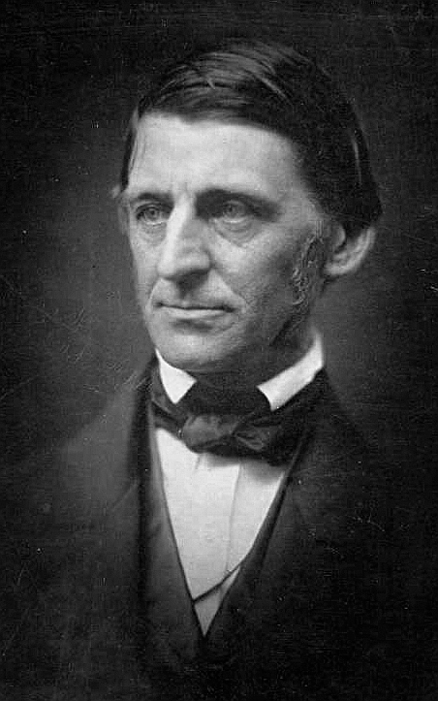
Ralph Waldo Emerson
Father of Transcendentalism
“Trust Thyself”
Wrote: “Self-Reliance”
“Nature”

Slide 8
Nature
In the presence of nature, Emerson feels exhilarated, restored, and part of God
We delight in nature
We find something in nature as beautiful as our own spiritual nature
Even though we’re all connected... We shouldn't rely on each other

Slide 9
Emerson’s “Nature”
Why did he write this? What’s his point?
How do man and nature relate to each other?
What does Emerson mean when he says he becomes "a transparent eye-ball" (442)?
In what way does nature serve as a teacher?

Slide 10
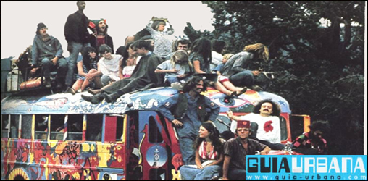
Closure
Emerson is considered the father of transcendentalism, what about his nature essay do you think made people buy into this movement?
http://www.youtube.com/watch?v=m5k9x16yYGo

