Slide 1
Thursday Before the bell
Vocabulary Completing the Sentence
Your Quiz is Tomorrow!

Slide 2
Welcome to Unit 2
Recap of our last unit!
http://www.youtube.com/watch?v=4p-bWA1FOqs
Introduction to our next unit!
http://www.teachertube.com/viewVideo.php?video_id=96576

Slide 3
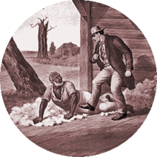
Romanticism
America’s borders and global influence expanded substantially in the years following the American Revolution.
Manifest destiny was the idea that westward expansion was America’s destiny.
What were the problems with America expanding west past the Mississippi?

Slide 4
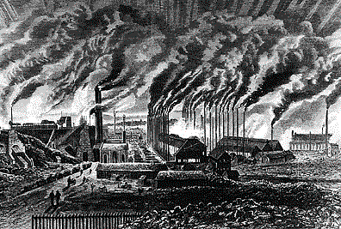
Growth of America
As the country grew, so did its resources. Many of those resources were sent back east.
Factories & new technology were revolutionizing America since they had been forced to produce their own goods following the collapse of their trade with Great Britain.

Slide 5
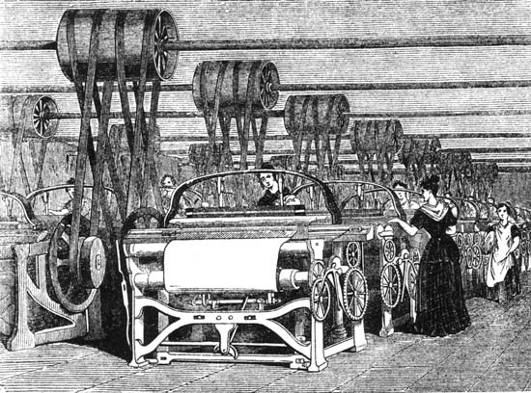
Industrial revolution
People moving to cities and towns instead of farms
Long hours, low wages in harsh factory conditions
Demand for Cotton skyrocketed forcing increased role and expansion of slavery.
Instead of the Patriotism of the revolutionary writers many started to take part in Sectionalism – myself before the nation

Slide 6
Romanticism
Romantics looked to nature and the individual for inspiration.
They were against slavery & industrialization.
They did not like the Puritan ideals that had dominated American thought for 200 years.
In fact, they weren’t really keen on any religion.
If Puritan’s were our strict grandparents, and the Enlightened Revolutionaries were our smart parents, the Romantics fall into the moody teenagers of the time!

Slide 7
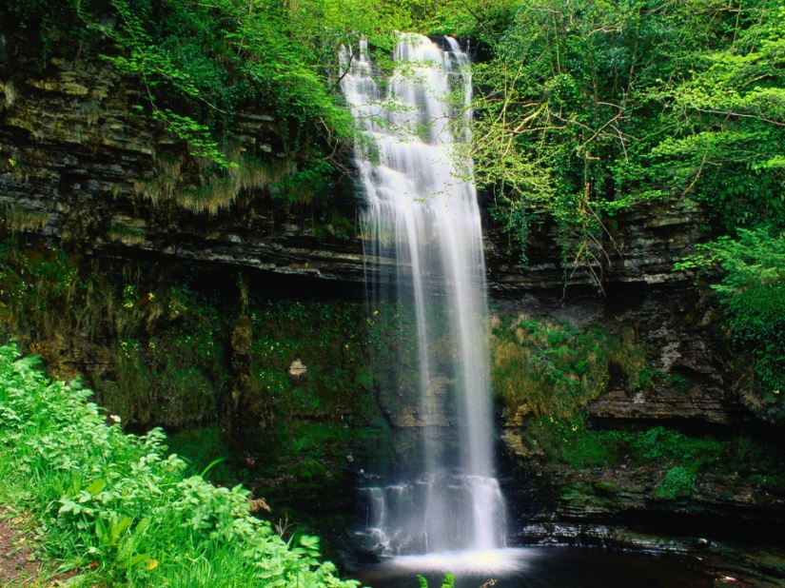
The Early Romantics
Emphasized emotions and the imagination over reason
Were advocates for social reform
Celebrated the Individual Spirit
As the U.S. expanded, American writers captured that spirit of growth and inspiration
Unlike the Puritans, Romantic writers were more influenced by Nature and by the Individual Spirit rather than God.

Slide 8
Puritans vs. Romantics
PURITANS | Nature: Nature was Wild, Savage, and source of fear | Man: Man was basically Evil | Humanity: Emphasis on Society and Community | Writing Style: Simple, conservative, religious, community-oriented
ROMANTICS | Nature was source of inspiration; A Spiritual Connection with Self and Supernatural | Man was basically GOOD | Emphasis on the INDIVIDUAL | Spontaneous, Descriptive, Emotional, Reflective, Inspirational!

Slide 9
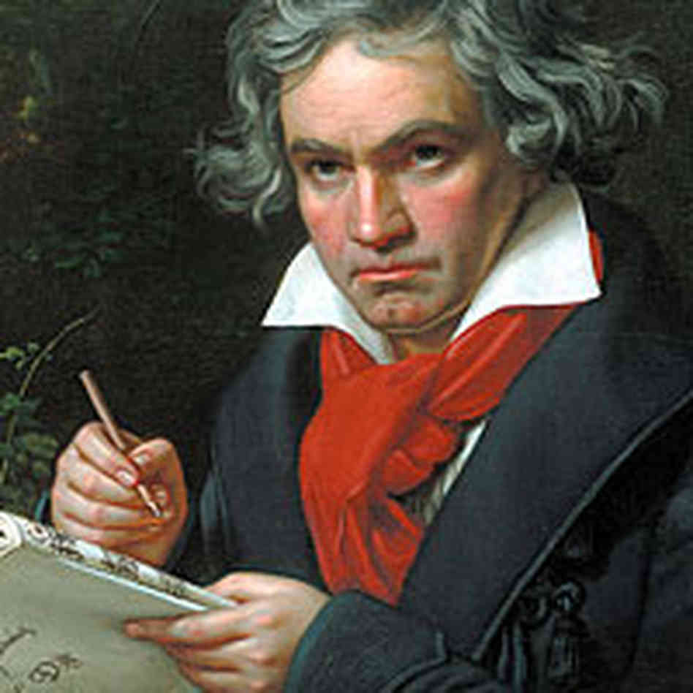
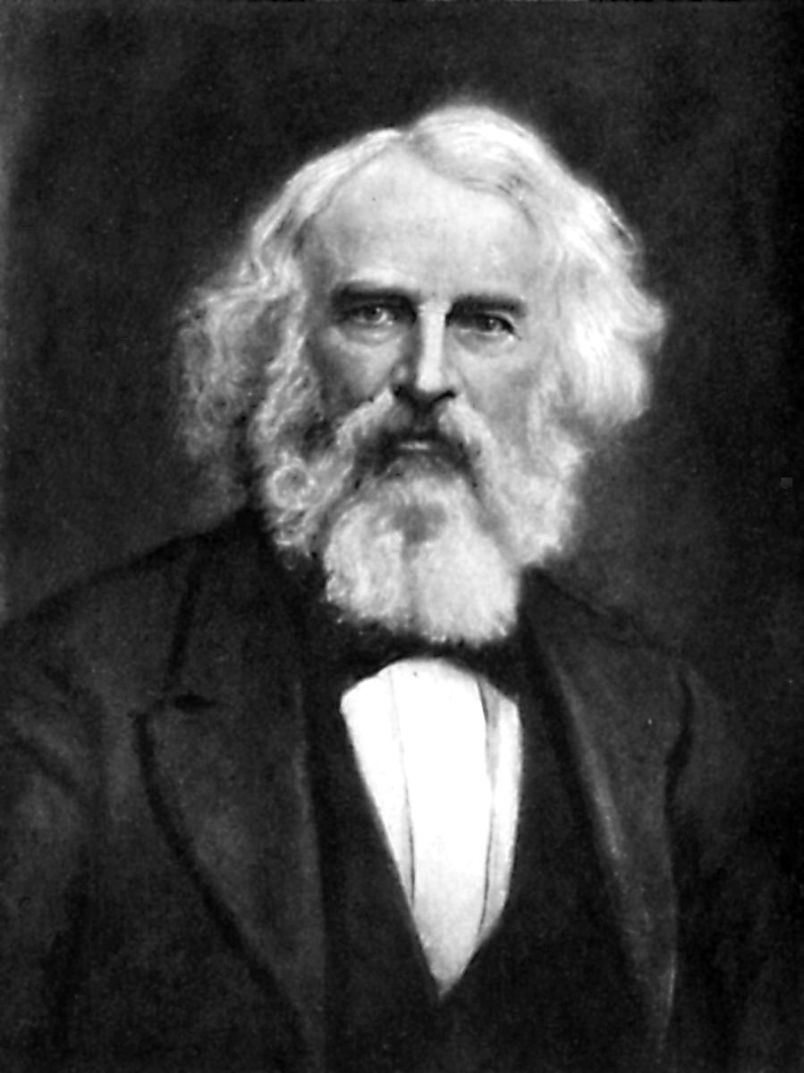
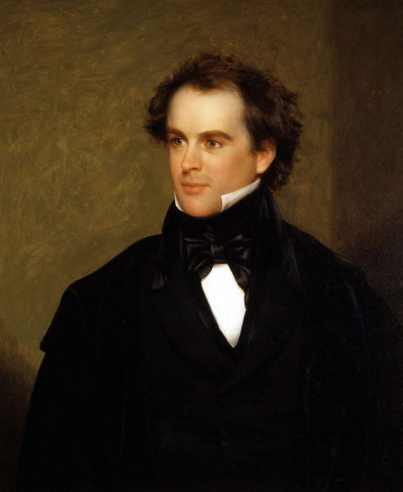
3 TYPES OF WRITERS IN ROMANTICISM
Fire Side Poets –Named because they were easy to read by the fire with Family
Focused on Individualism and Nature and were well known for social reform
William Cullen Bryant, Henry Wadsworth Longfellow, Oliver Holmes
Transcendentalist- Emphasize living a simple life and finding our truth in nature
Personal Emotion and Imagination
Ralph Waldo Emerson, Henry David Thoreau
Gothic “Brooding Romantics”- Emphasize individualism
Satirical, Emotional, Deal with the Occult, Vivid imagery
Washington Irving, Edgar Allan Poe, Nathaniel Hawthorne

Slide 10
Unit 2 Overview
Count off by 5’s to complete a Unit 2 overview survey
Each group will receive a set of flashcards.
While reading the introduction (P.302) you will match up your two sets of cards.
Ex. A Blue and a Pink card will match up
Two Blue Cards will not match up
You will also EACH fill out 12 question responses to turn in for a grade. (Put in Notes)

Slide 11
1. What is Romanticism?
2. How did romantic writers respond to the Industrial Revolution?
3. When did Romanticism first emerge?
4. What is nationalism?
5. What literary movement arose because of nationalism?
6. Who were the Fireside poets?
7. Describe the Fireside poets.
8. What is transcendentalism?
9. Who were the fathers of American transcendentalism?
10. What were gothic elements?
11. Describe the “brooding” romantics.
12. Where did the gothic tradition begin?

Slide 12
Create a Romantic Hero
When you finish...
On your own, turn to P. 317
After reading about the Romantics, develop your own Romantic Hero!
Draw what this hero would look like and write a paragraph to describe how they exemplify key aspects of the romantic time period!

Slide 13
Closure
Present your romantic heroes!
Discussion Response- Q & A
Think about the price of progress, not the dollar amount, but what you actually have to give up for the progress of a society.
Think of a couple examples of progress in your lifetime and the cost of this progress. Elaborate with detail.

