Slide 1
Vocabulary Unit 3

Slide 2
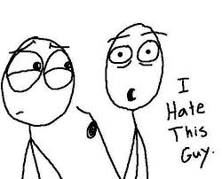
Abominate
To have an intense dislike or hatred for

Slide 3
Acculturation
The modification of the social patterns, traits, or structures of one group or society by contact with those of another; the resultant blend

Slide 4
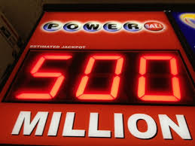
Adventitious
Resulting from chance rather than from an inherent cause or character; accidental, not essential; (medicine) acquired, not congenital

Slide 5
Ascribe
To assign or refer to (as a cause or source), attribute

Slide 6
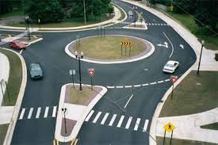
Circuitous
Roundabout, not direct

Slide 7
Commiserate
To sympathize with, have pity or sorrow for, share a feeling of distress

Slide 8
Enjoin
To direct or order; to prescribe a course of action in an authoritative way; to prohibit; to urge someone

Slide 9
Expedite
To make easy, cause to progress faster, speed up

Slide 10
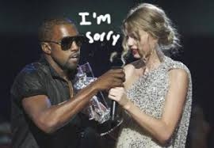
Expiate
to make amends, make up for; to avert

Slide 11
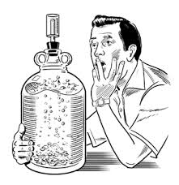
Ferment
A state of great excitement, agitation, or turbulence; (v.) to be in or work into such a state; to produce alcohol by chemical action

Slide 12
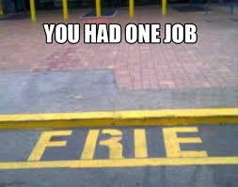
Inadvertent
Resulting from or marked by lack of attention; unintentional, accidental

Slide 13
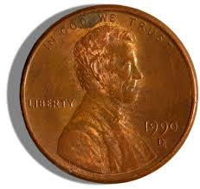
Nominal
Existing in name only, not real; too small to be considered or taken seriously

Slide 14
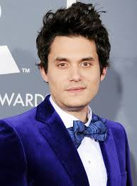
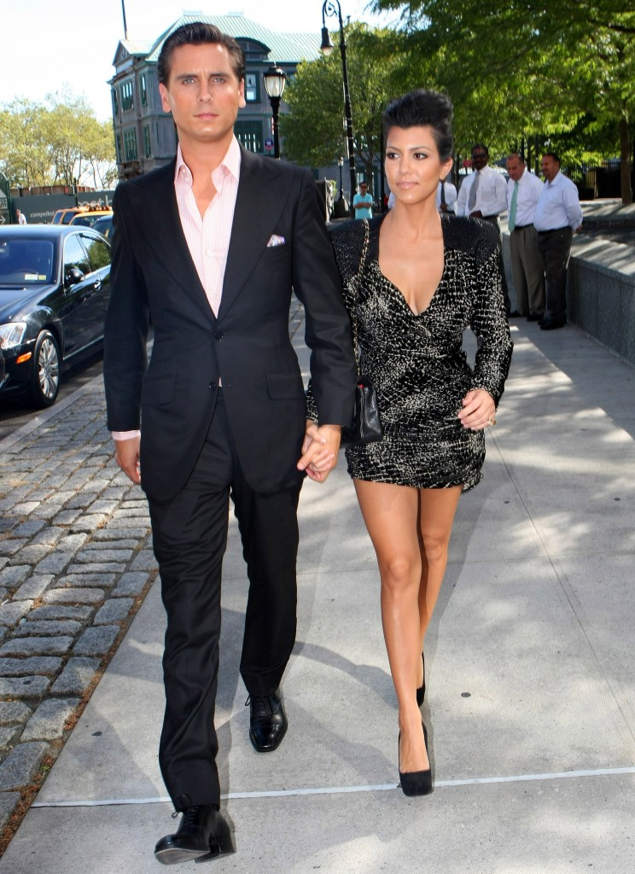
Noncommittal
Not decisive or definite; unwilling to take a clear position or to say yes or no

Slide 15
Peculate
to steal something that has been given into ones trust; to take improperly for ones own use

Slide 16
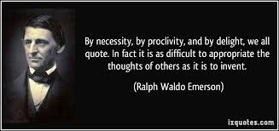
Proclivity
A natural or habitual inclination or tendency (especially of human character or behavior)

Slide 17
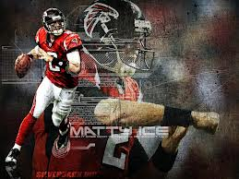
Sangfroid
Composure or coolness, especially in trying circumstances

Slide 18
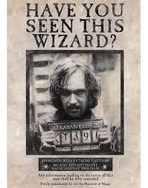
Seditious
Resistant to lawful authority; having the purpose of overthrowing an established government

Slide 19
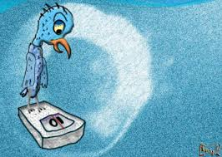
Tenuous
Thin, slender, not dense; lacking clarity or sharpness; of slight importance or significance; lacking a sound basis, poorly supported

Slide 20
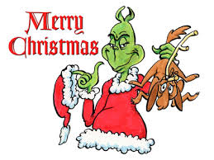
Vitriolic
bitter, sarcastic; highly caustic or biting (like a strong acid)

Slide 21
Wheedle
To use coaxing or flattery to gain some desired end

