Slide 1
UNIT 5 Vocab

Slide 2
amnesty
a general pardon for an offense against the government; in general, any act of forgiveness or absolution

Slide 3
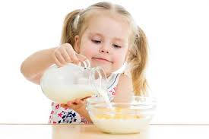
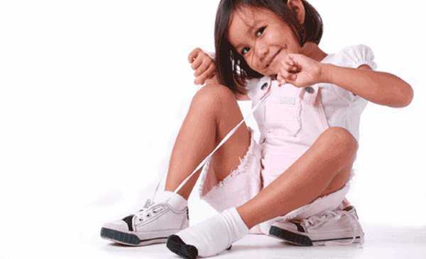
Autonomy
self-government, political control

Slide 4
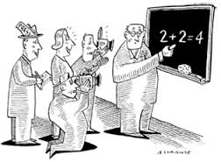
Axiomatic
self-evident, expressing a universally accepted principle or rule, unquestionable

Slide 5
Blazon
to adorn or embellish; to display conspicuously; to publish or proclaim widely

Slide 6
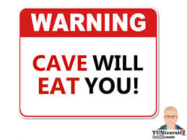
Caveat
a warning or caution to prevent misunderstanding or discourage behavior

Slide 7
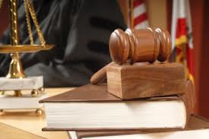
Equitable
fair, just, embodying principles of justice

Slide 8
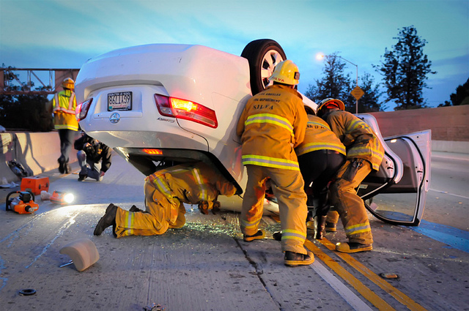
Extricate
to free from entanglements or difficulties; to remove with effort

Slide 9
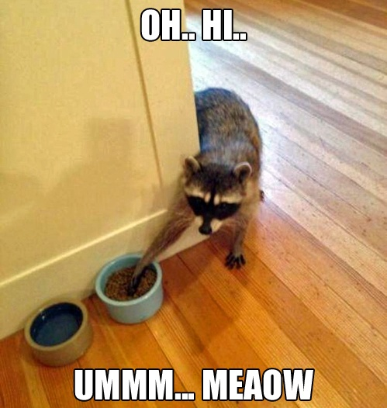
Filch
to steal, especially in a sneaky way and in petty amounts

Slide 10
FLOUT
to mock, treat with contempt

Slide 11
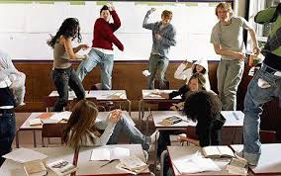
Fractious
tending to be troublesome; unruly, quarrelsome, contrary; unpredictable

Slide 12
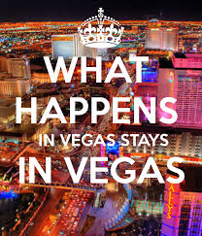
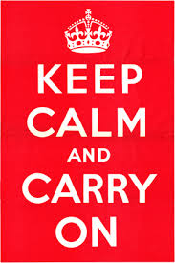
Precept
a rule of conduct or action

Slide 13
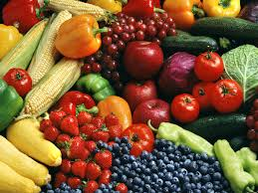
Salutary
beneficial, helpful; healthful, wholesome

Slide 14
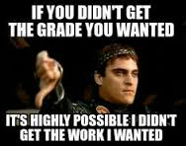
Scathing
bitterly severe, withering; causing great harm

Slide 15
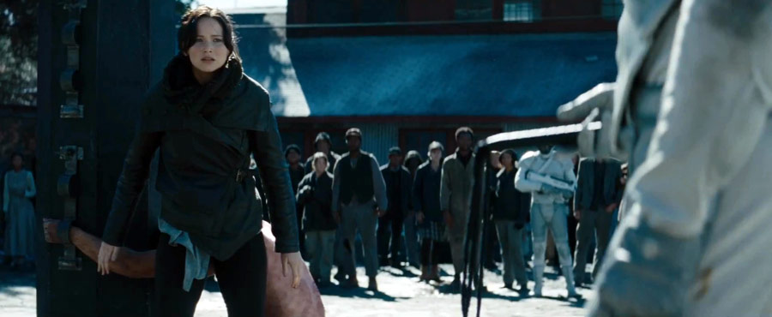
SCOURGE
(v) to whip, punish severely; (n) a cause of affliction or suffering; a source of severe punishment or criticism

Slide 16
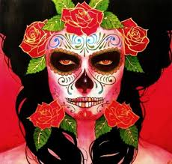
Sepulchral
funeral, typical of the tomb; extremely gloomy or dismal

Slide 17
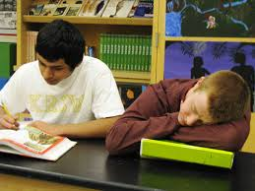
Soporific
adj) tending to cause sleep, relating to sleepiness or lethargy; (n) something that induces sleep

Slide 18
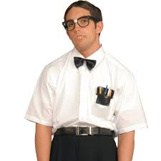
Straightlaced
extremely strict in regard to moral standards and conduct; prudish, puritanical

Slide 19
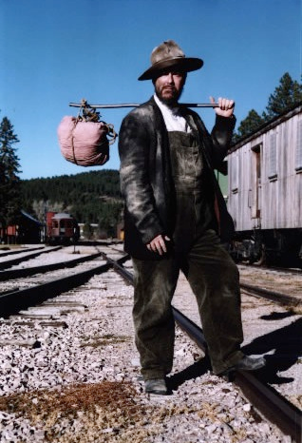
Transient
(adj) lasting only a short time, fleeting; (n) one who stays only a short time

Slide 20
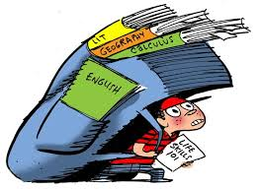
UNWIELDY
not easily carried, handled, or managed because of size or complexity

Slide 21
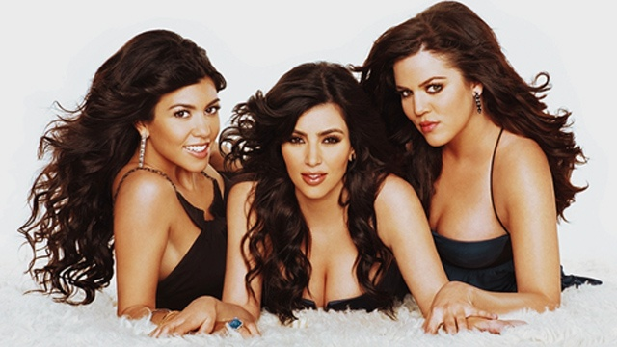
Vapid
dull, uninteresting, tiresome; lacking in sharpness, flavor, liveliness, or force

