Slide 1
Give me liberty or give me death…. or at least my students sitting in their desk with paper and pencils ready to go!

Slide 2
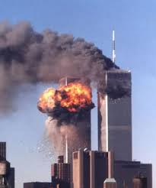
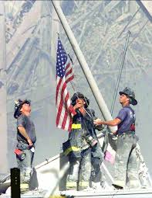
Warm Up:
On September 11, 2001, many Americans were shocked and concerned. President Bush delivered this speech causing us to wage war against terrorism.
In a journal answer :
Why do you think this is a persuasive speech?
What rhetoric does he use ethos, pathos, logos?
http://youtu.be/YMiqEUBux3o

Slide 3
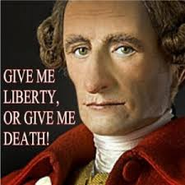
Patrick Henry Virginia Convention
1775 Delegates from the colonies met at the Virginia Convention; We were still part of England so no Congress/Senate
Patrick Henry gave a speech urging the delegates to form a militia as peace was no longer an option.
Members of the delegate including George Washington were in the audience and had to decide America’s fate.
http://www.youtube.com/watch?v=vY-8V6garUc

Slide 4
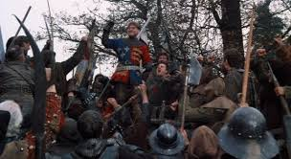
Henry V St. Crispin Day
In Shakespeare’s St. Crispin Day Speech takes place during the 100 year wars between England and France (England wanted the throne in France sound familiar?)
King Henry V in battle with French troops is outnumbered and gives his last rousing speech to his troops going into battle. Shockingly they won!
http://youtu.be/A-yZNMWFqvM

Slide 5
Now you will go into your assigned Groups
America’s 1-8 you will analyze Patrick Henry’s “Virginia Convention” Speech on your worksheet
British 1-8 you will analyze Shakespeare’s “St. Crispin Day” Speech on your worksheet
Next: All groups will play the ‘bad guys’ and take on their author’s speech and create their own counterargument on the back of your worksheet.

Slide 6
Find your Matching Country Group
Example America 1 goes with British 1
Help your opposing side fill in their worksheets for figurative language, rhetoric, and tone
Share your groups argument claim/support and your counterargument!

Slide 7
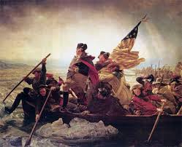
Closure
What made these speeches so similar?
What made them different?
Did they both have the same tone?
Did they both have the same effect on their audience?

