Slide 1
Vocab Unit 1

Slide 2
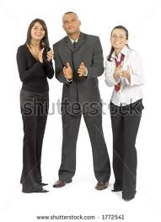
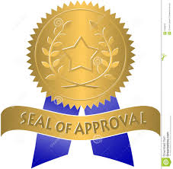
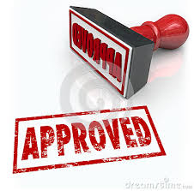
Approbation
The expression or approval or favorable opinion, praise

Slide 3
Assuage
To make easier or milder, relieve; to quiet, calm; to put an end to, appease, satisfy, quench

Slide 4
Coalition
A combination, union, or merger for some specific purpose

Slide 5
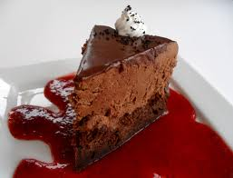
Decadence
Decline, decay, or deterioration; a condition or period of decline or decay; excessive self indulgence

Slide 6
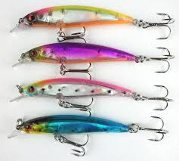
Elicit
To draw forth, bring out from some source

Slide 7
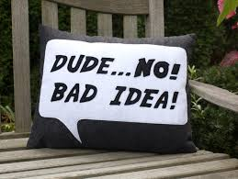
Expostulate
To attempt to dissuade someone from some course or decision by earnest reasoning

Slide 8
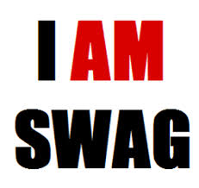
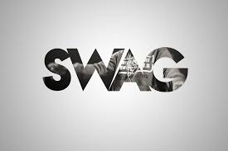
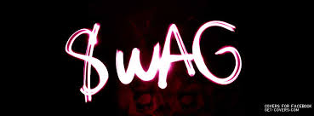
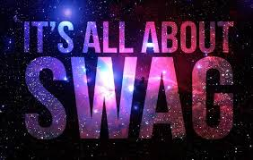
Hackneyed
Used so often as to lack freshness or originality

Slide 9
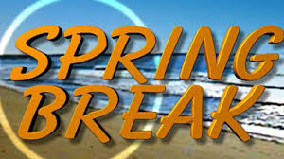
Hiatus
A gap, opening, break (in the sense of having an element missing)

Slide 10
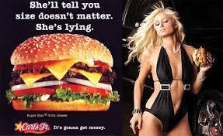
Innuendo
A hint, indirect suggestion, or reference (often in a derogatory sense)

Slide 11
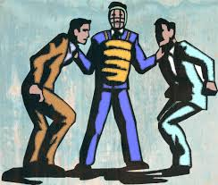
Intercede
To plead on behalf of someone else; to serve as a third party or go-between in a disagreement

Slide 12
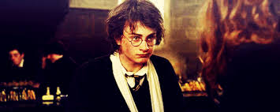
Jaded
Wearied, worn-out, dulled (in the sense of being satiated by excessive indulgence)

Slide 13
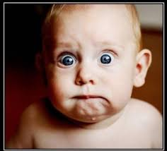
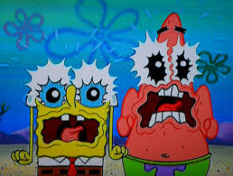
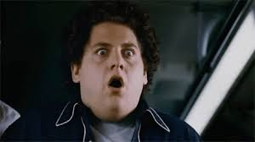
Lurid
Causing shock, horror, or revulsion; sensational; pale or sallow in color; terrible or passionate in intensity or lack of restraint

Slide 14
meritorious
Worthy, deserving recognition and praise

Slide 15
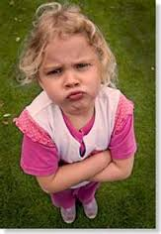
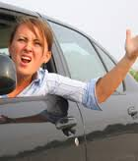
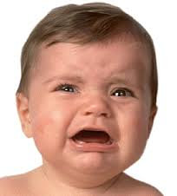
Petulant
Peevish, annoyed by trifles, easily irritated and upset

Slide 16
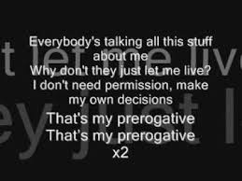
Prerogative
A special right or privilege; a special quality showing excellence

Slide 17
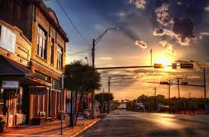
Provincial
Pertaining to an outlying area; local; narrow in mind or outlook, countrified in the sense of being limited and backward; of a simple plain design that originated in the countryside; (n.) a person with a narrow point of view; a person from an outlying area; a soldier from a province or colony

Slide 18
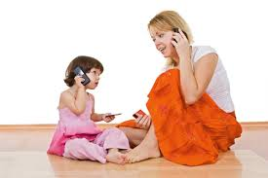
Simulate
To make a pretense of, imitate; to show the outer signs of

Slide 19
Transcend
To rise above or beyond, exceed

Slide 20
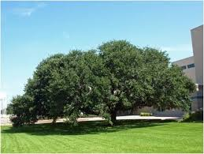
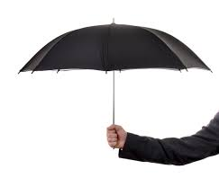
Umbrage
Shade cast by trees; foliage giving shade; an overshadowing influence or power; offense, resentment; a vague suspicion

Slide 21
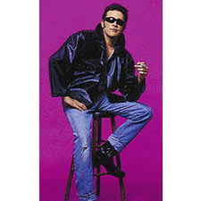
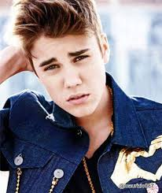
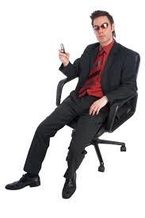
Unctuous
Excessively smooth or smug; trying too hard to give an impression of earnestness, sincerity, or piety; fatty, oily; pliable

