Slide 1
VOCAB UNIT 2

Slide 2
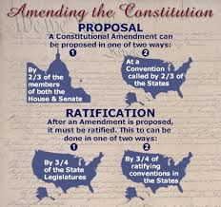
Ameliorate
Improve make better
The American people will ameliorate or amend the Constitution.

Slide 3
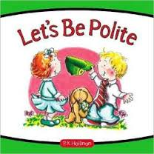
Aplomb
Great self confidence, poise
You handled that classmates attack with great aplomb!

Slide 4
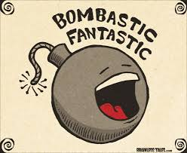
Bombastic
Pompous overblown in language; full of high-sounding words intended to conceal a lack of ideas
Edward Taylor used quite bombastic language to make his congregation fear leaving Puritanism!

Slide 5
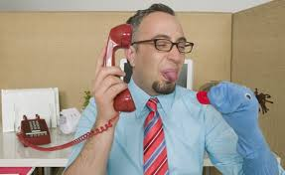
Callow
Without experience or immature
Sometime high school students can be so callow!

Slide 6
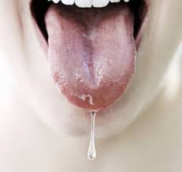
Drivel
Saliva or mucous or utter nonsense
I did not know the answers to the test so I put down utter drivel.

Slide 7
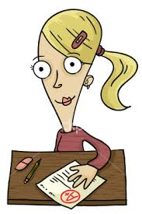
Epitome
An instant that represents a larger reality, a condensed account
My students with all A’s are the epitome of the best students!

Slide 8
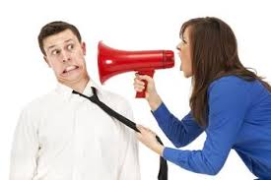
Exhort
To urge strongly!
I exhort my students to study for their Unit 1 test!

Slide 9
Ex officio
Virtue of holding a certain office
The president is the ex officio commander-in-chief of the armed forces.

Slide 10
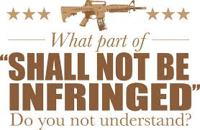
Infringe
To go beyond bounds, violate, trespass

Slide 11
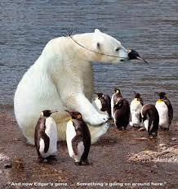
Ingratiate
To make oneself agreeable and thus gain favor or acceptance
It is not a good idea to ingratiate oneself by paying compliments to people you don’t mean.

Slide 12
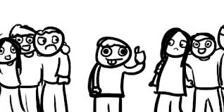
Interloper
One who moves in where he or she is not wanted or has no right, intruder!
Jennifer became an interloper when she interrupted our conversation!

Slide 13
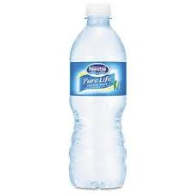
Intrinsic
Belonging to someone or something by its very nature, ESSENTIAL!
Water is an intrinsic part of life!

Slide 14
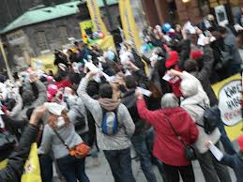
Inveigh
To make a violent attack in words, strong disapproval!
You should not inveigh against the teacher until you have heard what she is trying to help you learn!

Slide 15
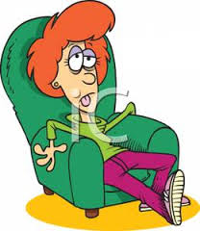
Lassitude
Weariness of body or mind lack of energy!
Many of my students are overcome with lassitude in class and I will make sure to wake them up!

Slide 16
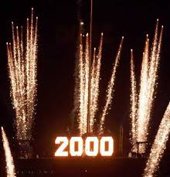
Millennium
A period of one thousand year; a period of great joy!
The year 2000 marked the start of the millennium

Slide 17
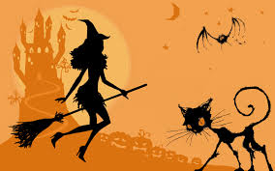
Occult
Secret, hidden from view not detectable, matters that involve the supernatural
The occult topic tends to be featured in the show American Horror Story

Slide 18
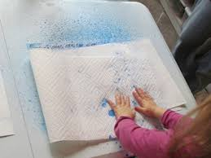
Permeate
To spread through, penetrate soak through
I spilled so much water that when I cleaned up it was permeating the paper towel

Slide 19
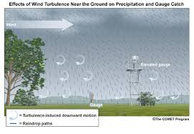
Precipitate
To fall as moisture; bring about suddenly to hurl down
The weather man says it will precipitate this weekend!

Slide 20
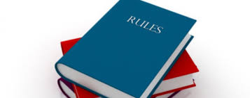
Stringent
Strict severe; rigorously or urgently biding or compelling
Some argue that AK’s rules are too stringent.

Slide 21
Surmise
To think or believe with our supporting evidence; lacks definite proof
When students don’t cite textual evidence Mrs. Nickell surmises that they do not know how to.

