Slide 1
Vocab Unit 7

Slide 2
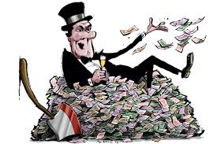
Austere
Severe or stern in manner; simple; plain; harsh

Slide 3
Beneficent
Performing acts of kindness or charity; conferring benefits doing good.

Slide 4
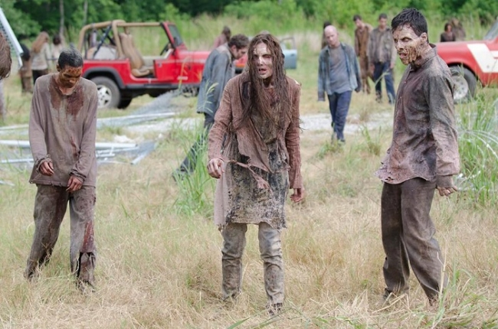
Cadaverous
Pale, gaunt, resembling a corpse

Slide 5
Concoct
Prepare by combining ingredients, make up to devise, fabricate

Slide 6
crass
Coarse unfeeling, stupid

Slide 7
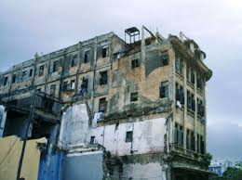
debase
Lower in character quality or value, to deteriorate

Slide 8
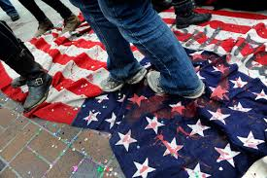
desecrate
Commit sacrilege upon to treat irreverently, to contaminate or pollute

Slide 9
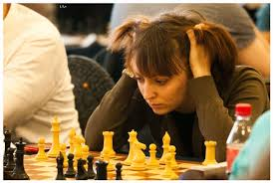
disconcert
To confuse; to disturb the composure of

Slide 10
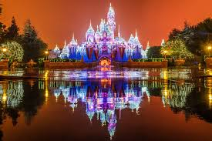
grandiose
Grand in an impressive or stately way; absurdly exaggerated

Slide 11
inconsequential
Trifling, unimportant

Slide 12
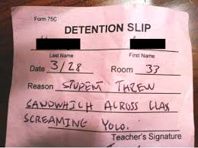
INFRACTION
A breaking of a law or obligation

Slide 13
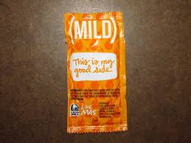
mitigate
Make milder or softer; to moderate in intensity

Slide 14
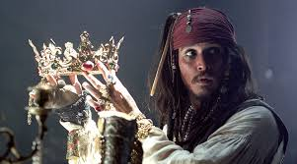
pillage
Rob of goods by open force, act of looting

Slide 15
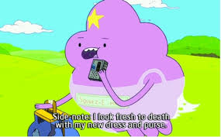
prate
To talk a great deal in a foolish or aimless fashion

Slide 16
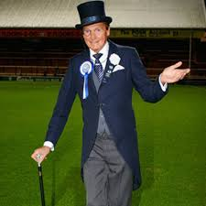
punctilious
Very careful and exact attentive to fine points of etiquette

Slide 17
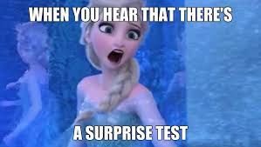
REDOUBTABLE
Inspiring fear or awe; illustrious eminent

Slide 18
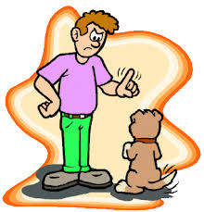
REPROVE
Find fault with, scold, rebuke

Slide 19
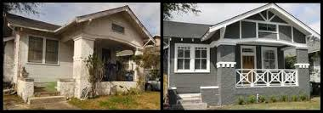
RESTITUTION
Act of restoring someone or something to rightful owner or to a former state or position.

Slide 20
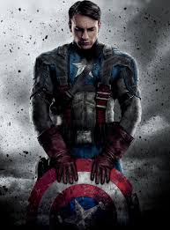
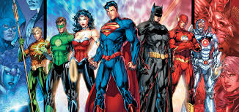
stalwart
Strong and sturdy, brave, resolute, brave person

Slide 21
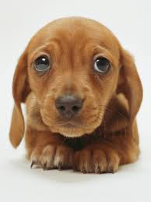
vulnerable
Open to attack capable of being wounded or damaged unprotected

