Slide 1
Before Bell
Get out your vocabulary books and assignment trackers!
Today’s date is 10/27 write down Vocabulary Book Check (I will come around and check this for you!)

Slide 2
Vocabulary Unit 4
Quiz on 10/30

Slide 3
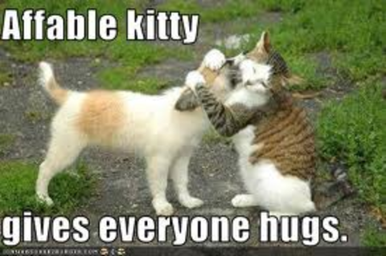
Affable
Courteous and pleasant, sociable, easy to speak to . (Friendly, Nice to be around!)

Slide 4
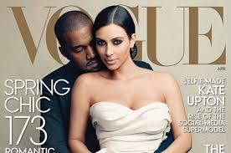
Aggrandize
To increase in greatness, power, or wealth; to build up or intensify; to make appear greater
Many would say Kanye helped to aggrandize Kim Kardashian.

Slide 5
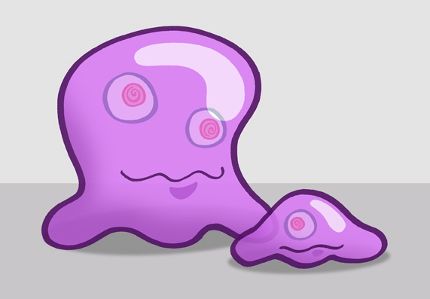
Amorphous
Shapeless, no definite form, with out organization or cohesion

Slide 6
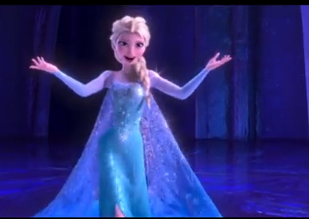
Archetype
An original model on which something was patterned or replicated
Elsa fits the archetype of rags to riches in Frozen

Slide 7
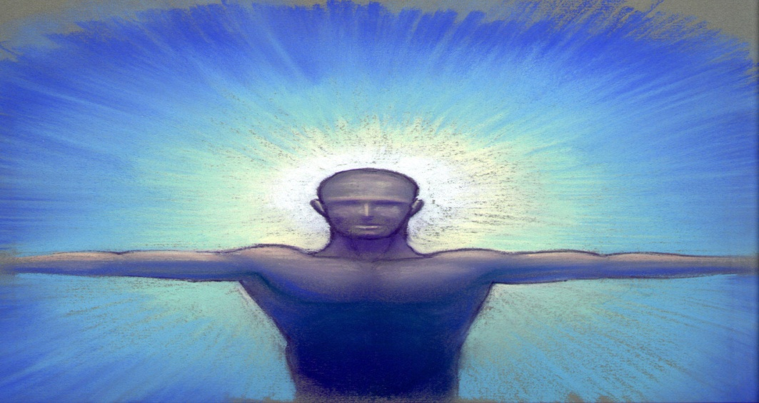
Aura
An atmosphere, or distinct personal quality (Vibes)
Jennifer has a typically calm aura about her today.

Slide 8
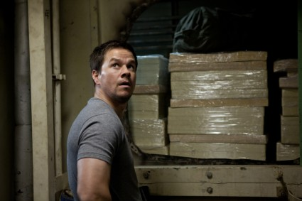
Contraband
Illegal traffic, smuggled goods
If you buy Black-market items most of it is contraband being brought into the US.

Slide 9
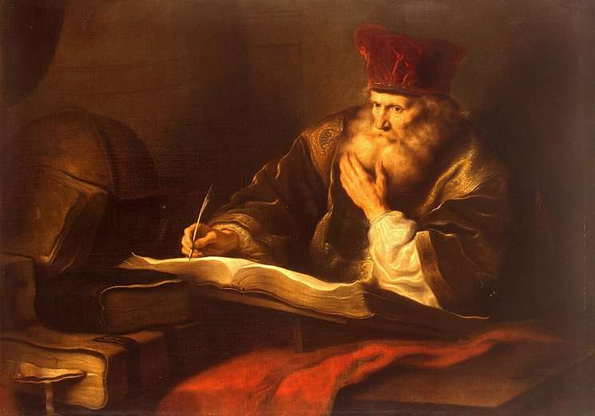
Erudite
Scholarly, learned, bookish, Pedantic (SMART)

Slide 10
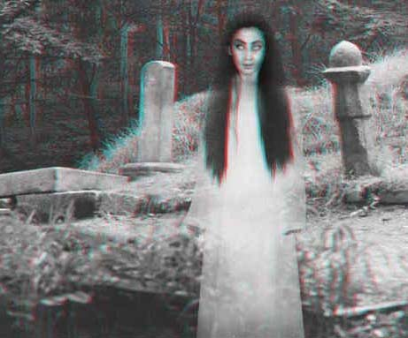
Gossamer
Thin , light delicate, insubstantial
Ghosts often are described as wearing gossamer clothing that makes them even more scary.

Slide 11
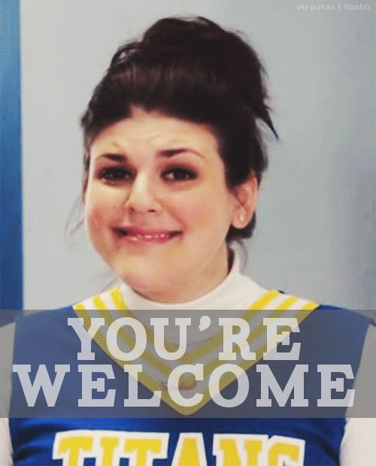
Inscrutable
Incapable of being understood; not able to see through physically.
Sadie’s smile is inscrutable as to if she is sincere or not.

Slide 12
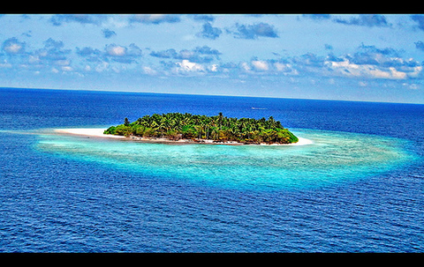
Insular
Relating to characteristic of, or situation on an island, narrow or isolated outlook
Because he always grew up in the south he has very insular view of what it is like to live in California.

Slide 13
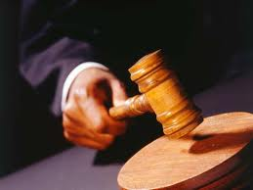
Irrevocable
Incapable of being changed or called back.
Once a judge has sentenced you for a crime it seems like an irrevocable punishment.

Slide 14
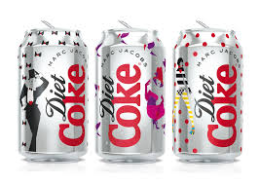
Propensity
A natural inclination or predilection toward. (your natural instinct)
Mrs. Nickell has a strong propensity towards drinking Diet Coke instead of water!

Slide 15
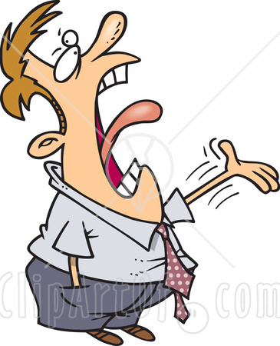
Querulous
Peevish, complaining, fretful (angry, irritated)

Slide 16
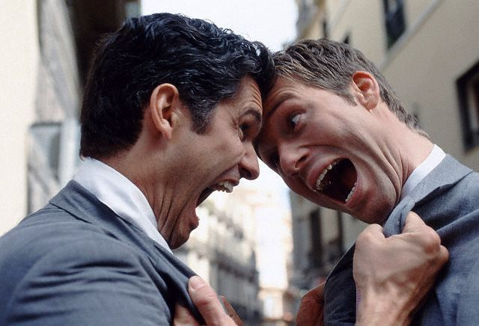
Remonstrate
To argue with someone against something, protest

Slide 17
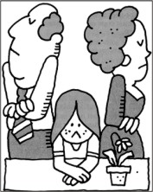
Repudiate
To disown, reject or deny the validity of

Slide 18
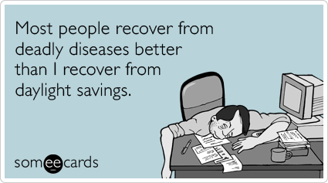
Resilient
Able to return to an original shape or form/recover quickly

Slide 19
Reverberate
To re-echo, reflect or be reflected, repeatedly
When listening to dub step when the beat drops it reverberates.

Slide 20
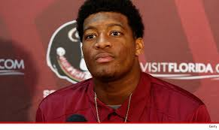
Scurrilous
Coarsely abusive, vulgar or low, foul mouthed
Mrs. Nickell believes that Jameis Winston is a very scurrilous person.

Slide 21
Sedulous
Persistent, showing industry and determination
The Walking Dead Characters are very sedulous in their pursuit to stay alive in a zombie apocolypse.

Slide 22
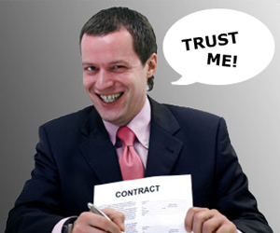
Sleazy
Thin or flimsy in texture; cheap; shoddy or inferior in quaintly or character.

