Slide 1
Vocab Unit 6

Slide 2
Anomalous
Abnormal, irregular, departing from the usual

Slide 3
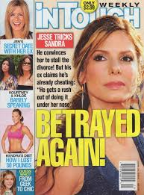
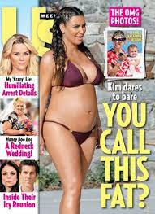
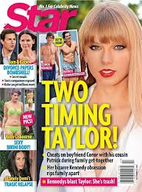
aspersion
A damaging or derogatory statement; the act of slandering or defaming

Slide 4
Bizarre
Extremely strange, unusual, atypical

Slide 5
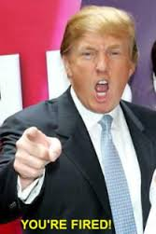
Brusque
Abrupt, blunt, with no formalities

Slide 6
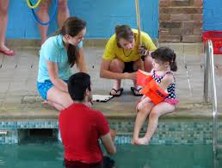
Cajole
To coax, persuade through flattery or artifice, to deceive with soothing thoughts or false promises

Slide 7
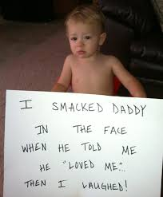
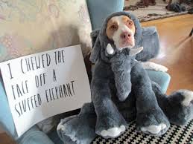
Castigate
To punish severely; to criticize severely

Slide 8
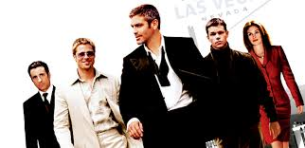
Contrive
To plan with ingenuity; to bring about through a plan

Slide 9
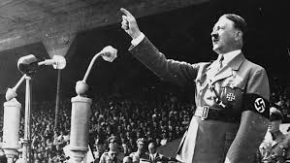
Demagogue
A leader who exploits popular prejudices and false claims and promises in order to gain power

Slide 10
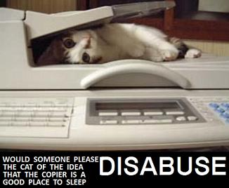
Disabuse
To free from deception or error set right in ideas or thinking

Slide 11
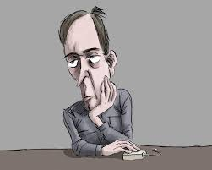
Ennui
Weariness and dissatisfaction from lack of occupation or interest, boredom

Slide 12
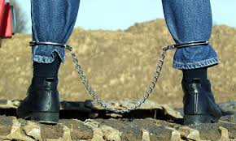
Fetter
A chain or shackle placed on the feet; to chain or shackle

Slide 13
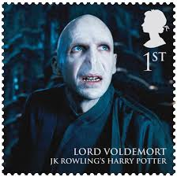
Heinous
Very wicked, offensive, hateful

Slide 14
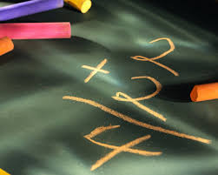
Immutable
Not subject to change, constant

Slide 15
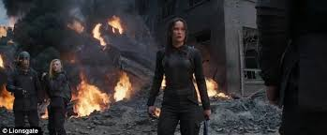
Insurgent
On who rebels or rises against authority

Slide 16
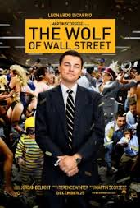
Megalomania
A delusion marked by a feeling of power, wealth, talent etc.

Slide 17
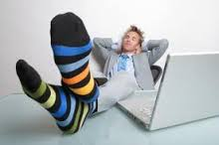
Sinecure
A position requiring little or no work; an easy job

Slide 18
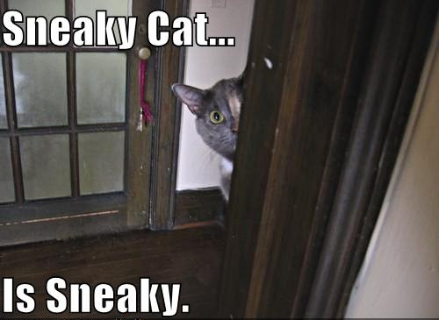
Surreptitious
Stealthy secret, intended to escape observations, made or accomplished by fraud

Slide 19
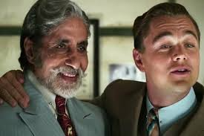
Transgress
To go beyond a limit or boundary; to sin; violate a law

Slide 20
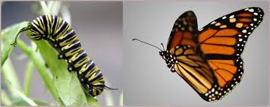
Transmute
To change from one nature, substance, or form to another

Slide 21
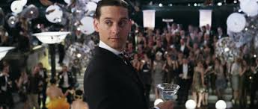
Vicarious
Performed, suffered, or otherwise experienced by one person in place of another

