Slide 1
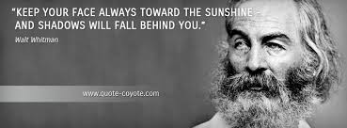
Warm Up:
http://www.youtube.com/watch?v=jiyIcz7wUH0
“That you are here—that life exists, and identity; That the powerful play goes on, and you will contribute a verse.”
Walt Whitman, Leaves of Grass
What do you think this quote means?
What does Whitman mean by “the Powerful play”?
What verse will you contribute?
Why do you think it is important to study poetry?

Slide 2
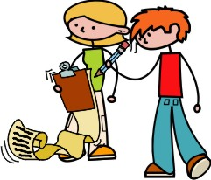
Realism/Regionalism/Naturalism
Scavenger hunt!
With a partner map your way through this literary movement on your notes then come back to your seats! You have 20 minutes!

Slide 3
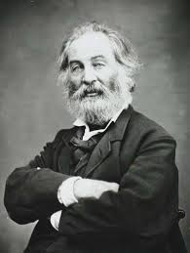
Whitman bio
1.Celebrated American life.
2. Wanted to “give something to [American] literature which will be our own.”
3. Wanted, in other words, to define American poetry.
4. Pablo Neruda said of him, some 100 years later, that Whitman was the first poet “to bear a truly American name.” What does this quote mean?

Slide 4
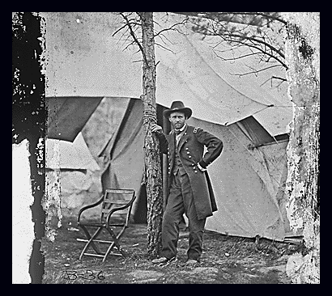
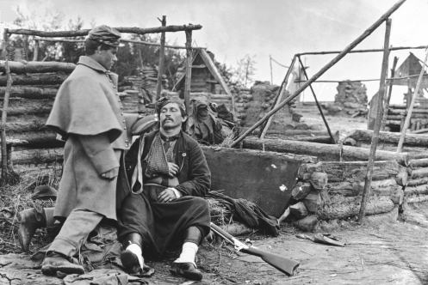
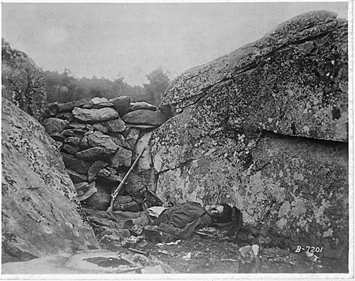
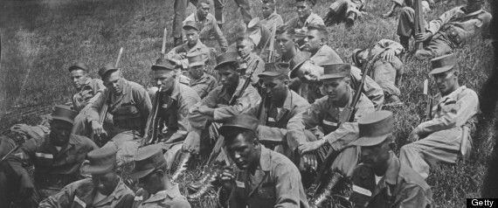

Slide 5
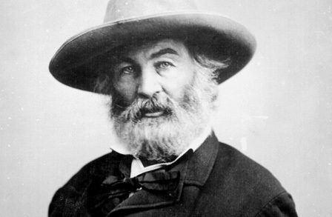
Whitman bio
Dramatically affected by the events of the Civil War.
In 1862, he joined his brother George on the Virginia battle front to treat his wounds.
Whitman’s brother’s wounds were slight, but Whitman stayed on.
He took a job in the Union army office.
But he mainly nursed wounded soldiers (both Union and Confederate).
He comforted the dying, dressed wounds, wrote letters for soldiers, brought gifts and read to them (not his own poetry).
Wrote several poems about the war (and Lincoln) and along with Matthew Brady’s photos and the letters from soldiers, these remain some of the most personal accounts of the Civil War.

Slide 6
Whitman bio
His tenderness for and affection of the soldiers cast doubt on his sexuality.
An English critic openly questioned whether or not Whitman was homosexual.
Whitman was offended and quickly set about having kids, fathering six bastards.
Kept his army job after the war until a stroke forced him to retire.
He was unembarrassed by disciples who saw him as the founder of a new religion of political and sexual liberation.
Oscar Wilde (a writer who was arrested in England for homosexuality) visited Whitman shortly before Whitman’s death.

Slide 7
Whitman style
Whitman experimented with a form of poetry called free verse.
What is free verse?
A review in Harper’s Magazine said of his poetry that it was “a new style [ . . . ] necessitated by new theories, new themes.”
Whitman said of it himself: “Every really new person [ . . . ] makes his style—sometimes a little removed from previous models—sometimes very far removed.”
His style can be described as bold and confident, much like the man himself.

Slide 8
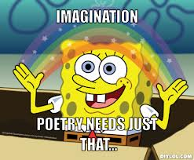
Whitman Poetic Style
Free Verse- no rhyme or structure to writing….NO RULES!
Repetition- repeated words or phrases
Cataloging- List of people or places
Parallelism- same grammatical structure

Slide 9
“I Hear America Singing” p. 532
Summarize. Name all the workers Whitman recounts in his poem.
Analyze. Why does Whitman list these workers?
Analyze. What is his attitude (tone) toward the workers?
Infer. Why does Whitman mention only regular people? What is he trying to tell us about America?
Chart. Give an example of each in the poem
Poem: | Cataloguing | Repetition | Parallelism
“I Hear America Singing”

Slide 10
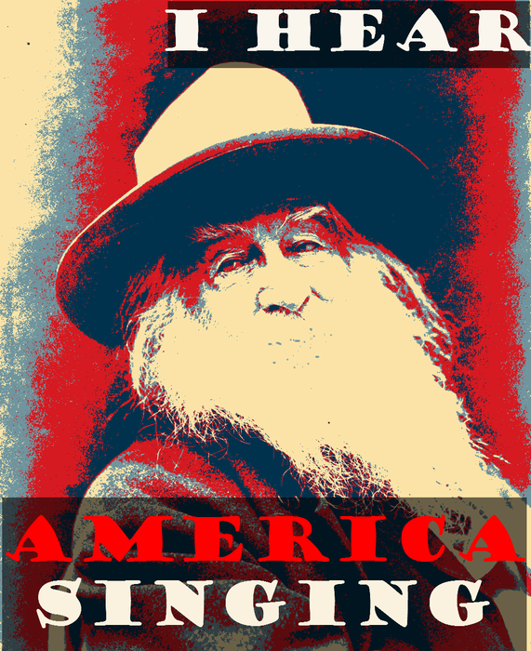
Creatively interpret the poem.
Working with a partner, create a poem after Whitman’s.
Possible topics: I hear AK singing; I hear my friends singing; I hear my athletic team/after school group singing; I hear my job singing; I hear my family singing.
After writing the poem identify the following: an audience for the poem, tone of the poem (with diction words to indicate tone) and theme.
Working with a partner, draw your new poem poem.
You should consider drawing the poem in the style of a comic strip.
Each panel will need a quote to justify the drawing.
Each quote will need an explanation. How is the example praising America?

Slide 11
“I Hear America . . . ” questions
1. The examples of all the workers in the poem are used to
a. celebrate the different voices that define life in America.
b. illustrate the problems of poor, working class Americans.
c. communicate the job possibilities that can be had in America.
d. extol the virtues of America's job creators.
2. What word choices best illustrates the speaker's subjective description of his subjects
a. measures, sewing c. blithe, melodious
b. mother, fellows d. young, open

Slide 12
“I Hear America . . . ” questions
3. Which one of the following words best helps the reader understand the time period in which the poem was written?
a. Steamboat c. Carols
c. Carpenter d. Mechanics
4. The main idea of the poem can best be stated as
a. America's diversity is part of its strength.
b. recognition isn't necessary for great work to be done.
c. the American working class has a difficult life.
d. no one will forget the people who created this great nation.
5. State Elaborate Exemplify (SEE) : How does Whitman celebrate American life?

